Slide 1
CS143: Disk
Professor Junghoo “John” Cho

Slide 2
System Architecture
CPU
System Bus
Disk Controller
...
Word
(1B – 64B)
~ 100 GB/sec
Block
(512B – 50KB)
~ 10 GB/sec
Disk
Main Memory

Slide 3
Magnetic disk vs SSD
Magnetic Disk
Stores data on a magnetic disk
Typical capacity: 1TB – 20TB
Solid State Drive (SSD)
Stores data in NAND flash memory
Typical capacity: 100GB – 10TB
Faster than magnetic disk
Particularly random disk access
But x5 more expensive and limited write cycles (~2000)

Slide 4
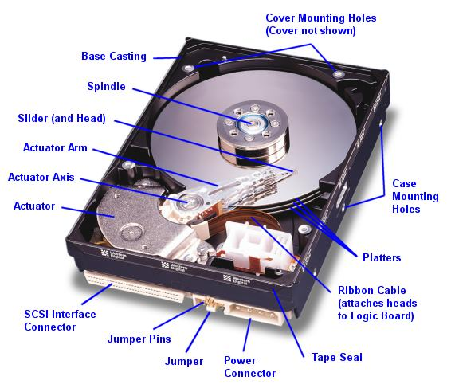

Slide 5
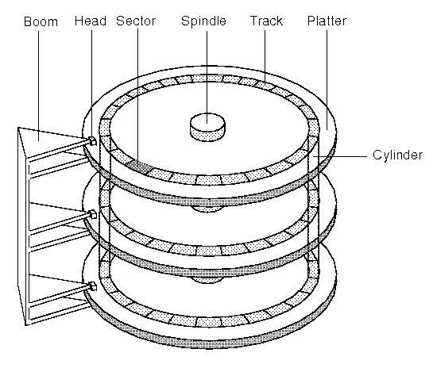

Slide 6
Structure of a Platter
Track, cylinder, sector (=block, page)
Data is transferred in the unit of “block” (not bytes) to amortize high access delay

Slide 7
Typical Magnetic Disk
Platter diameter: 2.5-5.25 in
Platters: 1 – 20
Tracks: 1000 – 50,000
Sectors per track: 1000 – 50,000
Sector size: 512 – 50K
Rotation speed: 1000 – 15000 rpm
Overall capacity: 1TB – 20TB

Slide 8
Access Time
CPU
Disk
Q: How long does it take to read a page of a disk to memory?
Q: What needs to be done to read a page?
page
Memory

Slide 9
Reading a Page From Disk
Q: What should happen to read the highlighted sector from disk?
Disk arm

Slide 10
Reading a Page From Disk
Q: What should happen to read the highlighted sector from disk?
Disk arm

Slide 11
Reading a Page From Disk
Q: What should happen to read the highlighted sector from disk?
Disk arm

Slide 12
Reading a Page From Disk
Q: What should happen to read the highlighted sector from disk?
Disk arm

Slide 13
Access Time
Access time = (seek time) + (rotational delay) + (transfer time)

Slide 14
Seek Time
Time to move a disk head between tracks
Track to track ~ 1ms
Average ~ 10 ms
Full stroke ~ 20 ms
5 - 20x
Time
x
1
N
Cylinders Traveled

Slide 15
Rotational Delay
Typical disk:
1000 rpm – 15000 rpm
Q: For 6000 RPM, average rotational delay?
Head Here
Block I Want

Slide 16
Transfer Time
Read blocks as
the platter rotates
6000RPM 10,000 sectors/track
Q: How long to read one sector?
Disk Head

Slide 17
Access Time
6000RPM, 10,000 sectors/track
Average access time to read one sector = (seek time) + (rotational delay) + (transfer time)

Slide 18
Transfer Rate
The rate at which we can transfer data from disk
Measured in bytes/sec
Q: 6,000 RPM, 10000 sectors/track, 1KB/sector what is the transfer rate?
Burst transfer rate vs Sustained transfer rate
(Burst) Transfer rate = (RPM / 60) * (sectors/track) * (bytes/sector)

Slide 19
Random I/O
For magnetic disks:
Random I/O is VERY expensive compared to sequential I/O
For SSD disks:
Random I/O is still expensive but not as much as for magnetic disks
Avoid random I/O to minimize delay
 | Magnetic | SSD
Random IO | ~100 IOs/sec | ~100K IOs/sec
Transfer rate | ~ 100MB/sec | ~ 10GB/sec

Slide 20
Buffers, Buffer pool
Temporary main-memory “cache” for disk blocks
Avoid future read
Hide disk latency
Most DBMS let users change buffer pool size

Slide 21
Abstraction by OS
1
Sequential blocks
No need to worry about head, cylinder, sector
Access to non-adjacent blocks
Random I/O
Access to adjacent blocks
Sequential I/O
2
3
4
.
.
.
(head, cylinder, sector)

Slide 22
Things to Remember
Platter, track, cylinder, block (sector)
Access time = seek time + rotational delay + transfer time
Random I/O vs Sequential I/O

