Slide 1
CS249:
Neural Language Model
Professor Junghoo “John” Cho

Slide 2
Today’s Topics
Yoshua Bengio, et al.: A Neural Probabilistic Language Model
High-level overview of machine learning

Slide 3
Language Model
Key question: When we read English, how likely will we encounter a particular sentence?
  “John could not sleep yesterday” vs “Poop grew went therefore”
Q: Where is it useful? Why do we care?
A: Many different applications!
  Spell/grammar correction: “John went there” vs “John went their”
  Speech recognition: again, “John went there”
  Sentence generation
  And many others…
Q: How can we make computers to answer the above question? How can we formalize our goal?

Slide 4
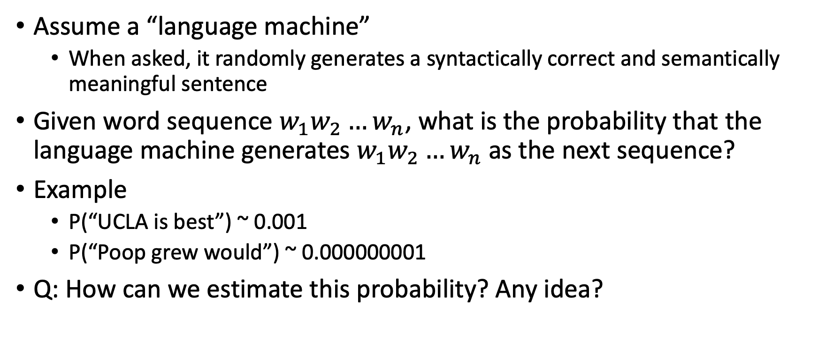
Language Model: Formalization
Assume a “language machine”
  When asked, it randomly generates a syntactically correct and semantically meaningful sentence
Given word sequence $w_{1}w_{2}…w_{n}$, what is the probability that the language machine generates $w_{1}w_{2}…w_{n}$ as the next sequence?
Example
  P(“UCLA is best”) ~ 0.001
  P(“Poop grew would”) ~ 0.000000001
Q: How can we estimate this probability? Any idea?

Slide 5
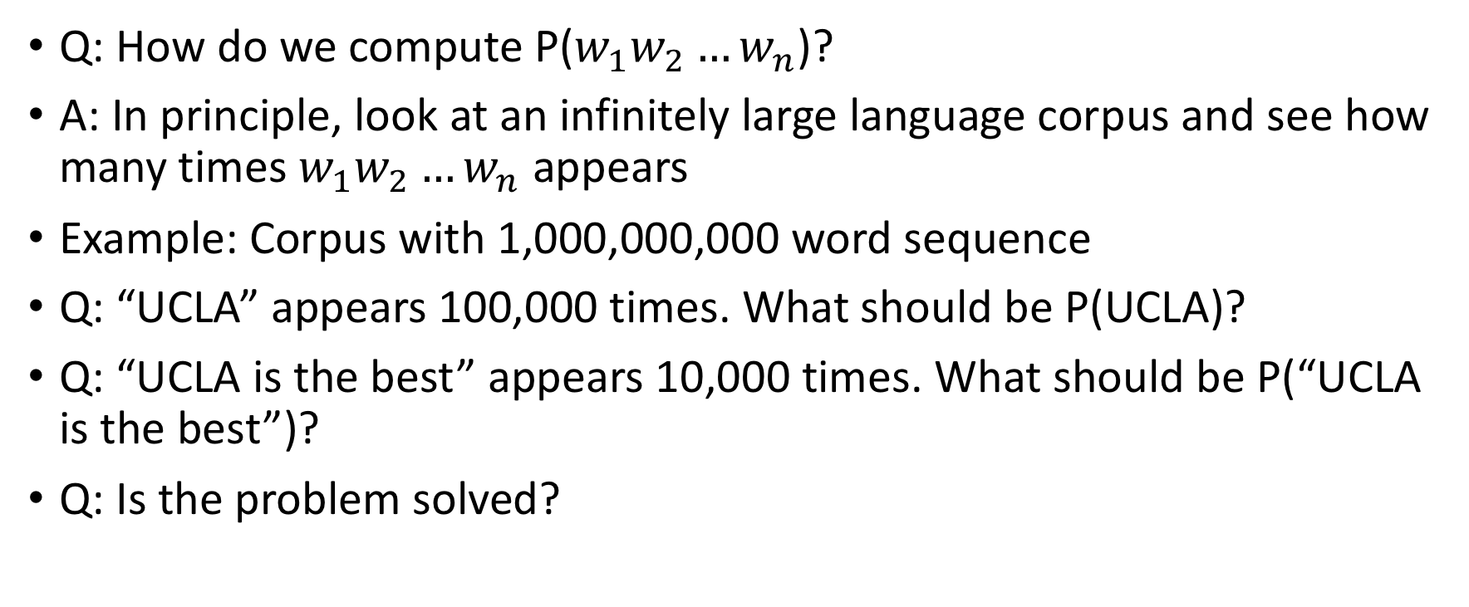
Estimating Language Model
Q: How do we compute P($w_{1}w_{2}…w_{n}$)?
A: In principle, look at an infinitely large language corpus and see how many times $w_{1}w_{2}…w_{n}$ appears
Example: Corpus with 1,000,000,000 word sequence
Q: “UCLA” appears 100,000 times. What should be P(UCLA)?
Q: “UCLA is the best” appears 10,000 times. What should be P(“UCLA is the best”)?
Q: Is the problem solved?

Slide 6
Curse of Dimensionality
Q: Assume 10,000 words in English. How many possible combinations of 4-word sequence (= 4-gram)?
Q: If we have a corpus of a trillion words, are we likely to see most 4-grams?
Even for a small n, we are unlikely to see most n-grams
Q: How to estimate P(sentence) when the sentence was never seen?
  “UCLA is located in a very expensive and safe neighborhood that everyone loves to visit”
  Assign P(sentence)=0?
We need ways to “estimate” P(sentence) for unseen sentence.
  Q: How?

Slide 7
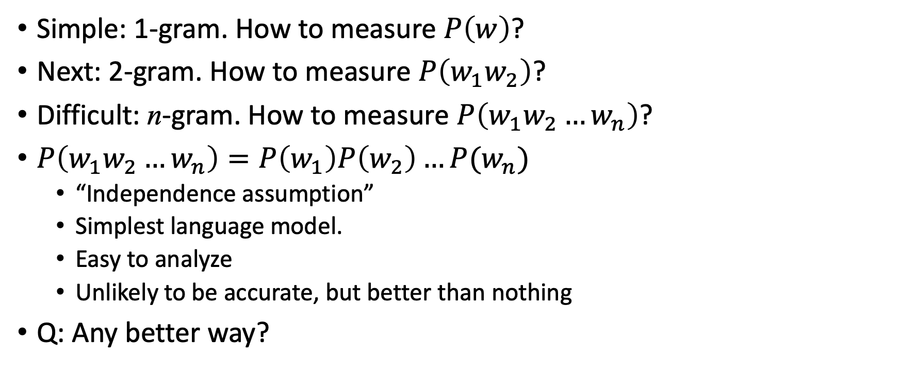
Estimating Language Model
Simple: 1-gram. How to measure $P\left(w\right)$?
Next: 2-gram. How to measure $P\left(w_{1}w_{2}\right)$?
Difficult: n-gram. How to measure $P\left(w_{1}w_{2}…w_{n}\right)$?
$P\left(w_{1}w_{2}…w_{n}\right)=P\left(w_{1}\right)P\left(w_{2}\right)…P(w_{n})$
  “Independence assumption”
  Simplest language model.
  Easy to analyze
  Unlikely to be accurate, but better than nothing
Q: Any better way?

Slide 8
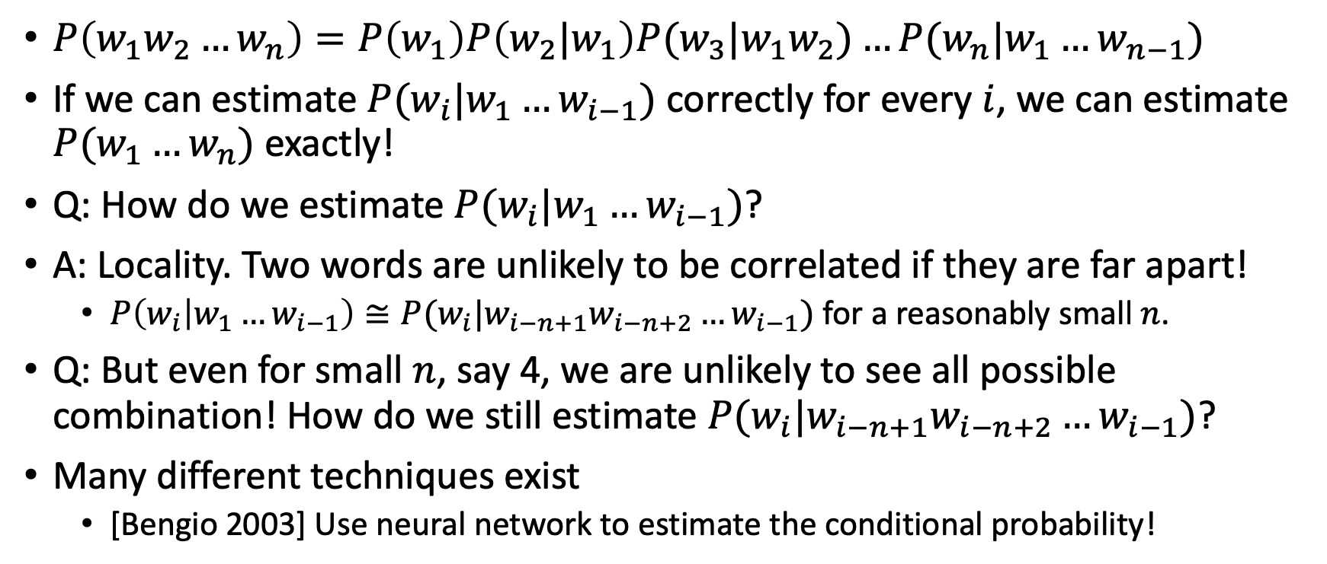
Chain Rule
$P\left(w_{1}w_{2}…w_{n}\right)=P\left(w_{1}\right)P\left(w_{2}|w_{1}\right)P(w_{3}|w_{1}w_{2})…P(w_{n}|w_{1}…w_{n−1})$
If we can estimate $P(w_{i}|w_{1}…w_{i−1})$ correctly for every $i$, we can estimate $P(w_{1}…w_{n})$ exactly!
Q: How do we estimate $P(w_{i}|w_{1}…w_{i−1})$?
A: Locality. Two words are unlikely to be correlated if they are far apart!
  $P\left(w_{i} | w_{1}…w_{i−1}\right)≅P(w_{i}|w_{i−n+1}w_{i−n+2}…w_{i−1})$ for a reasonably small $n$.
Q: But even for small $n$, say 4, we are unlikely to see all possible combination! How do we still estimate $P(w_{i}|w_{i−n+1}w_{i−n+2}…w_{i−1})$?
Many different techniques exist
  [Bengio 2003] Use neural network to estimate the conditional probability!

Slide 9
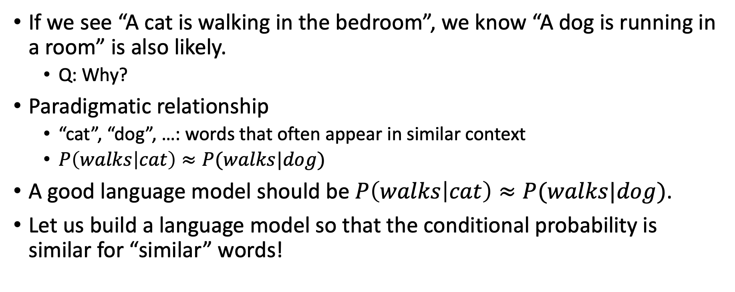
[Bengio 2003] Intuition
If we see “A cat is walking in the bedroom”, we know “A dog is running in a room” is also likely.
  Q: Why?
Paradigmatic relationship
  “cat”, “dog”, …: words that often appear in similar context
  $P\left(walks | cat\right)≈P(walks|dog)$
A good language model should be $P\left(walks | cat\right)≈P(walks|dog)$.
Let us build a language model so that the conditional probability is similar for “similar” words!

Slide 10

Notation
Use the notation $f_{i}\left(w_{1}, …,w_{i−1}\right)=P\left(w_{i} | w_{1}…w_{i−1}\right)$
  One function $f_{i}$ per every output word $w_{i}$
  There exists $V$ number of $f_{i}$ functions
Set $f=(f_{1},…, f_{V})$, the collection of $f_{i}′$s.
  $f$is a vector function that outputs a $V$-dimensional probability vector

Slide 11



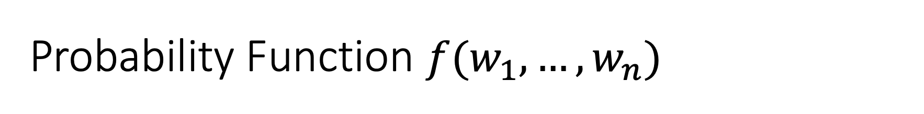




Probability Function $f(w_{1},…,w_{n})$
Function from $n$ $m$-dimensional vectors to a $V$-dimensional probability vector
  Each dimension in the output vector represents the probability of each word $w_{i}$
$$w_{1}$$
$$\left(\begin{matrix}w_{1}:0.03 \\ \begin{matrix}w_{2}:0.01 \\ ⋮\end{matrix} \\ w_{V}:0.05\end{matrix}\right)$$
$$w_{2}$$
$$f$$
$$⋮$$
$$w_{n}$$

Slide 12
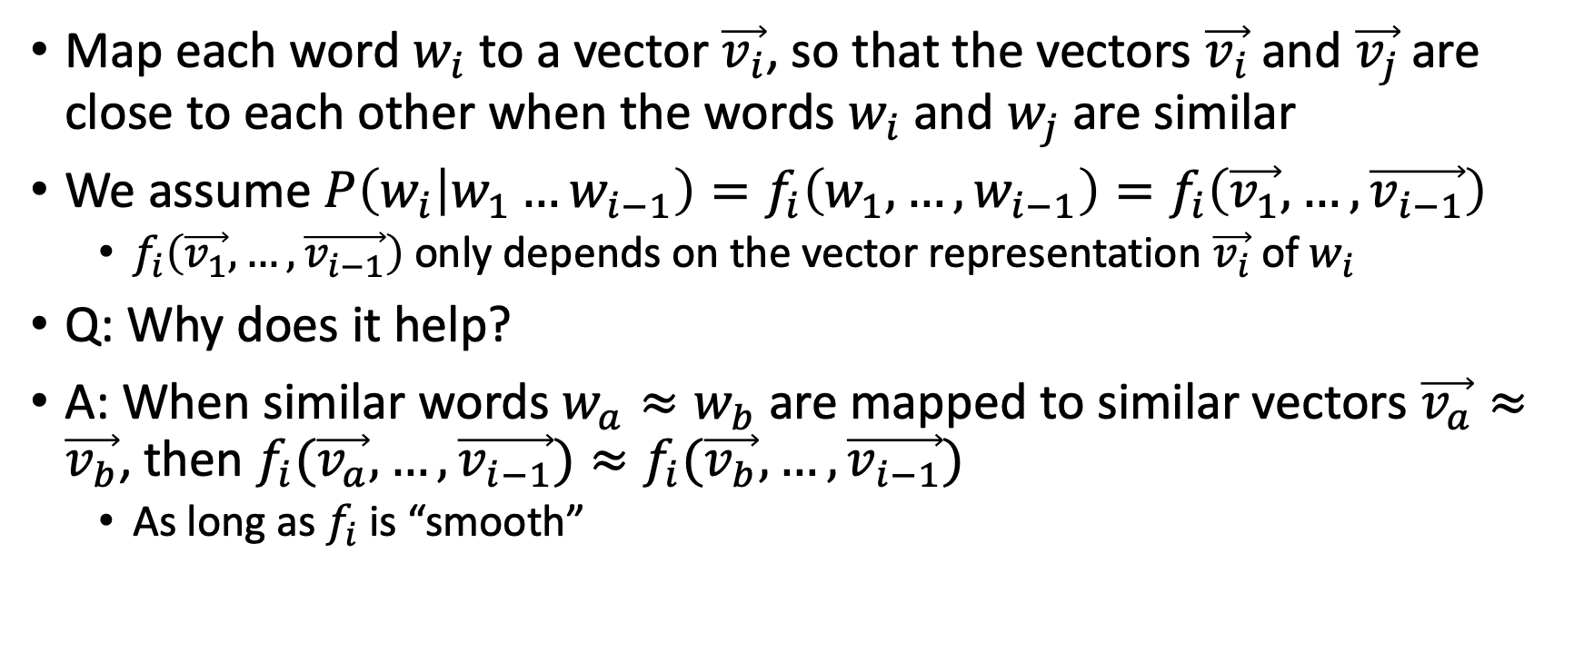
[Bengio 2003] Key Formulation
Map each word $w_{i}$ to a vector $\vec{v_{i}}$, so that the vectors $\vec{v_{i}}$and $\vec{v_{j}}$are close to each other when the words $w_{i}$and $w_{j}$are similar
We assume $P\left(w_{i} | w_{1}…w_{i−1}\right)=f_{i}\left(w_{1}, …,w_{i−1}\right)=f_{i}\left(\vec{v_{1}}, …,\vec{v_{i−1}}\right)$
  $f_{i}\left(\vec{v_{1}}, …,\vec{v_{i−1}}\right)$ only depends on the vector representation $\vec{v_{i}}$of $w_{i}$
Q: Why does it help?
A: When similar words $w_{a}≈w_{b}$ are mapped to similar vectors $\vec{v_{a}}≈\vec{v_{b}}$, then $f_{i}(\vec{v_{a}}, …,\vec{v_{i−1}})≈f_{i}(\vec{v_{b}}, …,\vec{v_{i−1}})$
  As long as $f_{i}$ is “smooth”

Slide 13

Probability Function $f(w_{1},…,w_{n})$
$$w_{1}$$
$$\left(\begin{matrix}0.03 \\ \begin{matrix}0.01 \\ ⋮\end{matrix} \\ 0.05\end{matrix}\right)$$
$$w_{2}$$
$$f$$
$$⋮$$
$$w_{n}$$

Slide 14

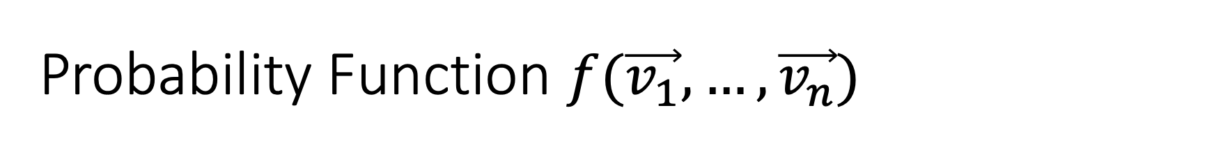


Probability Function $f(\vec{v_{1}},…,\vec{v_{n}})$
$$\vec{v_{1}}$$
$$\left(\begin{matrix}0.03 \\ \begin{matrix}0.01 \\ ⋮\end{matrix} \\ 0.05\end{matrix}\right)$$
$$\vec{v_{2}}$$
$$f$$
$$⋮$$
$$\vec{v_{n}}$$

Slide 15
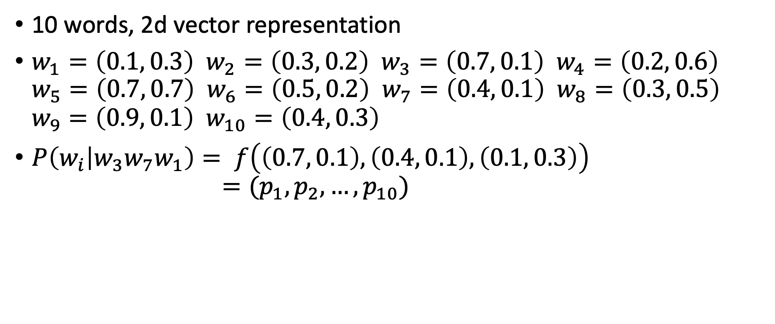
Example
10 words, 2d vector representation
$w_{1}=\left(0.1, 0.3\right)$ $w_{2}=\left(0.3, 0.2\right)$ $w_{3}=\left(0.7, 0.1\right)$ $w_{4}=\left(0.2, 0.6\right)$
$w_{5}=\left(0.7, 0.7\right)$ $w_{6}=\left(0.5, 0.2\right)$ $w_{7}=\left(0.4, 0.1\right)$ $w_{8}=\left(0.3, 0.5\right)$
$w_{9}=\left(0.9, 0.1\right)$ $w_{10}=\left(0.4, 0.3\right)$
$P\left(w_{i} | w_{3}w_{7}w_{1}\right)= f\left(\left(0.7, 0.1\right),\left(0.4, 0.1\right), \left(0.1, 0.3\right)\right)$
$=(p_{1},p_{2},…, p_{10})$

Slide 16

Open Questions
Q: How can we map words to vectors, so that similar words map to similar vectors?
Q: How do we obtain the function $f()$?
A: Use neural network and simultaneously find them!

Slide 17
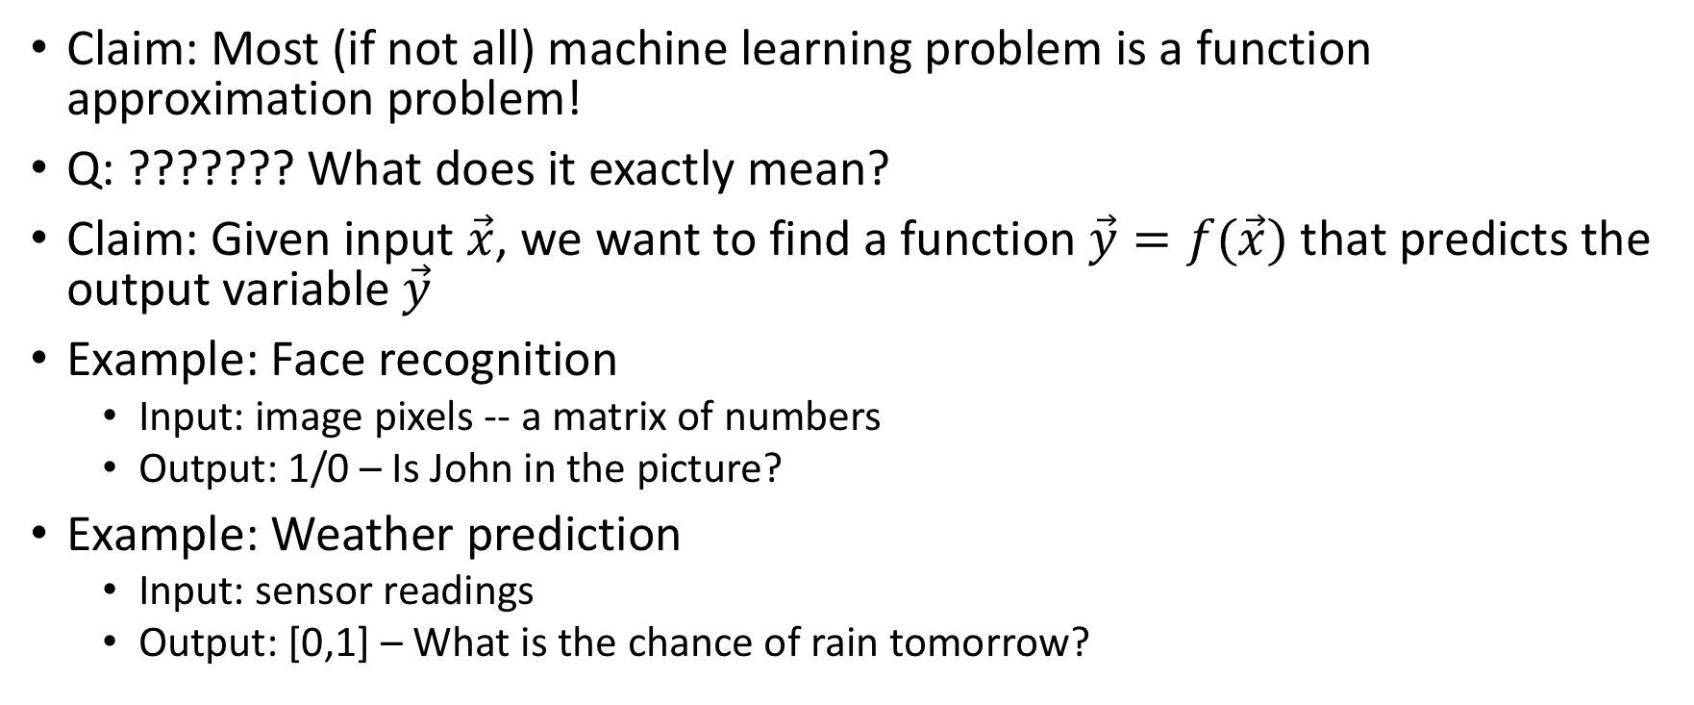
Machine Learning as Function Approximation
Claim: Most (if not all) machine learning problem is a function approximation problem!
Q: ??????? What does it exactly mean?
Claim: Given input $\vec{x}$, we want to find a function $\vec{y}=f(\vec{x})$ that predicts the output variable $\vec{y}$
Example: Face recognition
  Input: image pixels -- a matrix of numbers
  Output: 1/0 – Is John in the picture?
Example: Weather prediction
  Input: sensor readings
  Output: [0,1] – What is the chance of rain tomorrow?

Slide 18
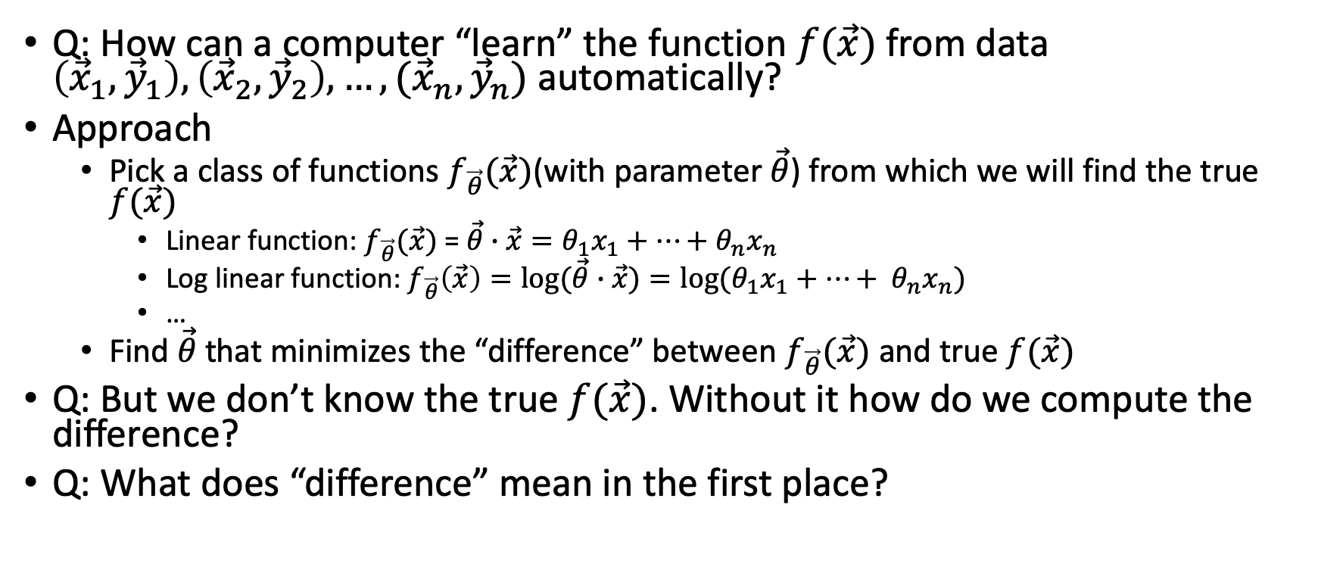
Machine Learning as Function Approximation
Q: How can a computer “learn” the function $f(\vec{x})$ from data $\left({\vec{x}}_{1},{\vec{y}}_{1}\right), \left({\vec{x}}_{2},{\vec{y}}_{2}\right), …, ({\vec{x}}_{n}, {\vec{y}}_{n})$ automatically?
Approach
  Pick a class of functions $f_{\vec{θ}}(\vec{x})$(with parameter $\vec{θ}$) from which we will find the true $f(\vec{x})$
    Linear function: $f_{\vec{θ}}(\vec{x})$ = $\vec{θ}∙\vec{x}=θ_{1}x_{1}+…+$ $θ_{n}x_{n}$
    Log linear function: $f_{\vec{θ}}\left(\vec{x}\right)=log⁡(\vec{θ}∙\vec{x})={log⁡(θ}_{1}x_{1}+…+ θ_{n}x_{n})$
    …
  Find $\vec{θ}$ that minimizes the “difference” between $f_{\vec{θ}}(\vec{x})$ and true $f(\vec{x})$
Q: But we don’t know the true $f(\vec{x})$. Without it how do we compute the difference?
Q: What does “difference” mean in the first place?

Slide 19
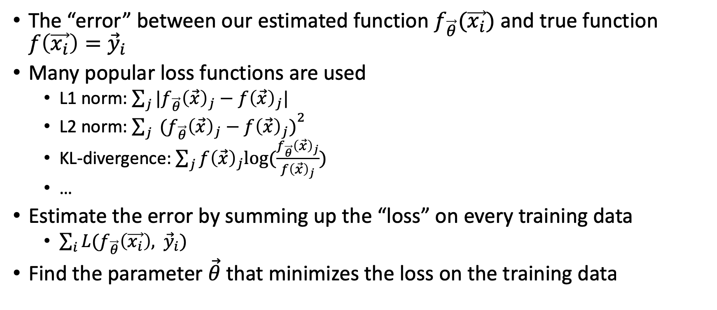
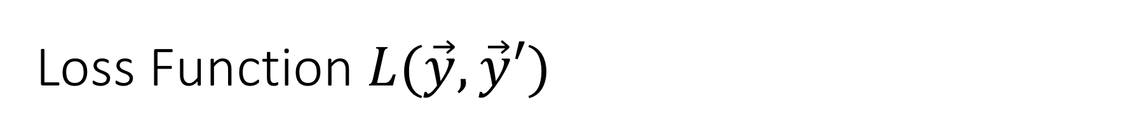
Loss Function $L(\vec{y},\vec{y}′)$
The “error” between our estimated function $f_{\vec{θ}}(\vec{x_{i}})$ and true function $f\left(\vec{x_{i}}\right)={\vec{y}}_{i}$
Many popular loss functions are used
  L1 norm: $\sum_{j}{|f_{\vec{θ}}{\left(\vec{x}\right)}_{j}−f{\left(\vec{x}\right)}_{j}|}$
  L2 norm: ${\sum_{j}{ (f_{\vec{θ}}{\left(\vec{x}\right)}_{j}−f{\left(\vec{x}\right)}_{j})}}^{2}$
  KL-divergence: $\sum_{j}{f{\left(\vec{x}\right)}_{j}log(\frac{f_{\vec{θ}}{\left(\vec{x}\right)}_{j}}{f{\left(\vec{x}\right)}_{j}})}$
  …
Estimate the error by summing up the “loss” on every training data
  $\sum_{i}{L(f_{\vec{θ}}\left(\vec{x_{i}}\right), }$ ${\vec{y}}_{i})$
Find the parameter $\vec{θ}$ that minimizes the loss on the training data

Slide 20
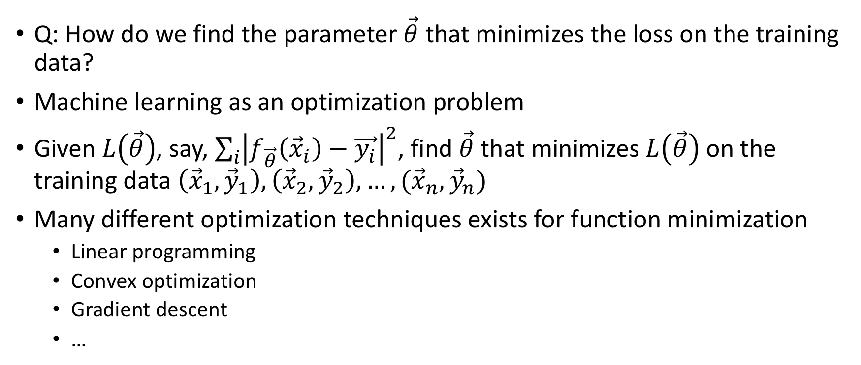

Finding $\vec{θ}$
Q: How do we find the parameter $\vec{θ}$ that minimizes the loss on the training data?
Machine learning as an optimization problem
Given $L\left(\vec{θ}\right)$, say, $\sum_{i}{{\left|f_{\vec{θ}}\left({\vec{x}}_{i}\right)−\vec{y_{i}}\right|}^{2}}$, find $\vec{θ}$ that minimizes $L\left(\vec{θ}\right)$ on the training data $\left({\vec{x}}_{1},{\vec{y}}_{1}\right), \left({\vec{x}}_{2},{\vec{y}}_{2}\right), …, ({\vec{x}}_{n}, {\vec{y}}_{n})$
Many different optimization techniques exists for function minimization
  Linear programming
  Convex optimization
  Gradient descent
  …

Slide 21

Summary: Machine Learning
Machine learning requires
  Training data: $\left({\vec{x}}_{1},{\vec{y}}_{1}\right), \left({\vec{x}}_{2},{\vec{y}}_{2}\right), …, ({\vec{x}}_{n}, {\vec{y}}_{n})$
  Choice of parameterized function (hypothesis space): $f_{\vec{θ}}(\vec{x})$
  Choice of loss function
  Optimization technique

Slide 22
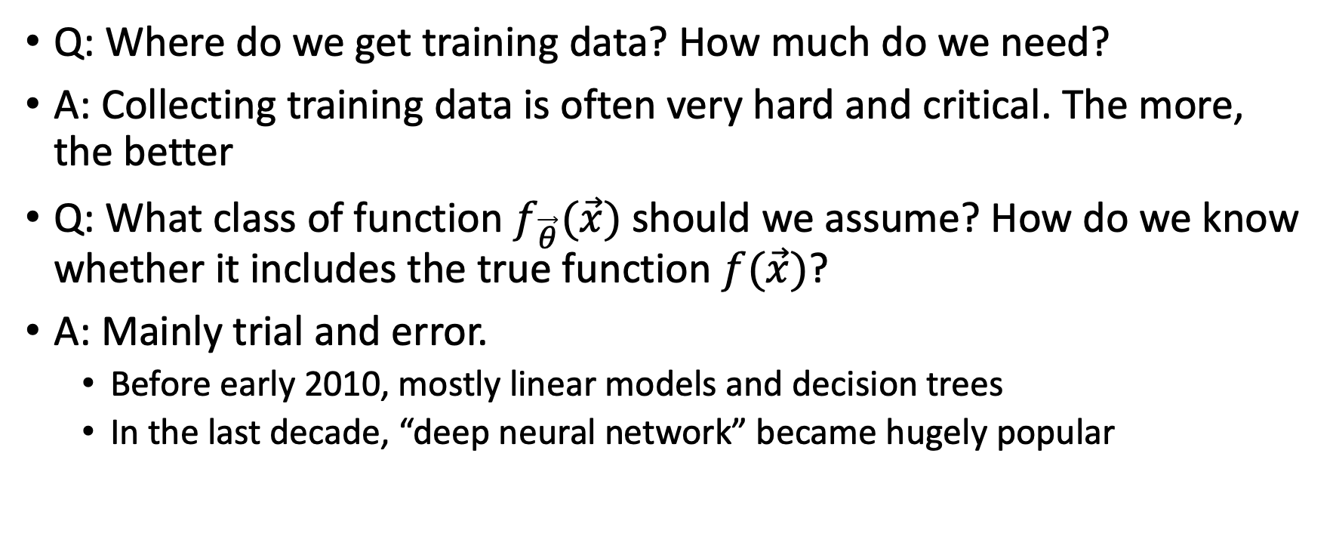
Questions on Machine Learning
Q: Where do we get training data? How much do we need?
A: Collecting training data is often very hard and critical. The more, the better
Q: What class of function $f_{\vec{θ}}(\vec{x})$ should we assume? How do we know whether it includes the true function $f(\vec{x})$?
A: Mainly trial and error.
  Before early 2010, mostly linear models and decision trees
  In the last decade, “deep neural network” became hugely popular

Slide 23
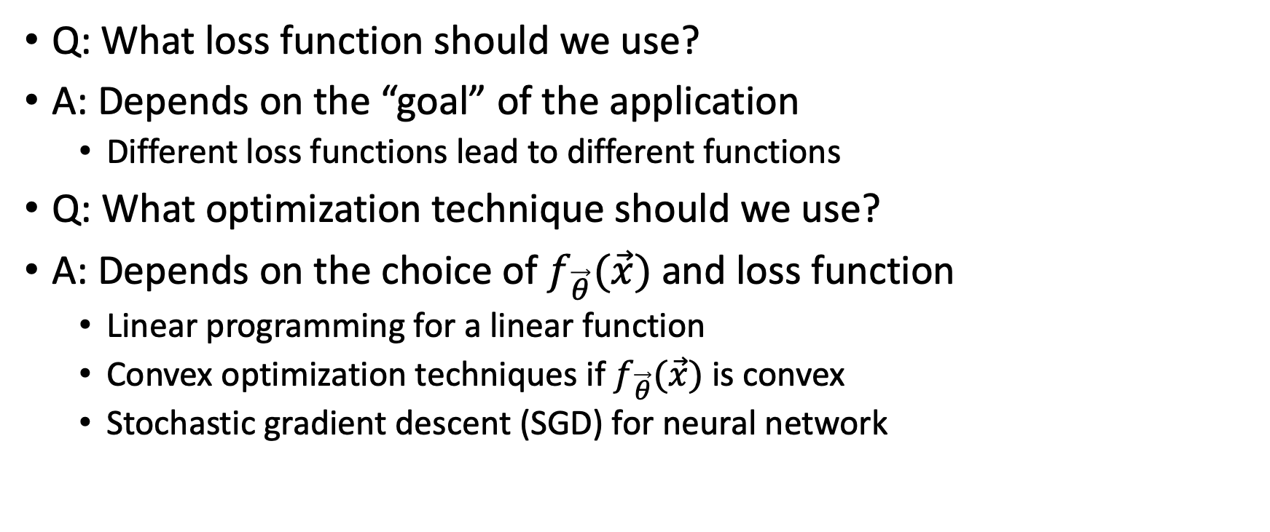
Questions on Machine Learning
Q: What loss function should we use?
A: Depends on the “goal” of the application
  Different loss functions lead to different functions
Q: What optimization technique should we use?
A: Depends on the choice of $f_{\vec{θ}}(\vec{x})$ and loss function
  Linear programming for a linear function
  Convex optimization techniques if $f_{\vec{θ}}(\vec{x})$ is convex
  Stochastic gradient descent (SGD) for neural network

Slide 24
“Understanding” an ML Paper
What is the input and output of our problem?
How is the problem mapped into a function approximation problem?
What hypothesis space was assumed? What loss function was used?
What technique is used to solve the loss optimization problem?
What data was used? How was the result evaluated?
You should have a clear answer to the above questions after reading a paper.

Slide 25
Announcements
Second paper summary is due before Monday lecture
  Tomas Mikolov, et al.: Distributed Representations of Words and Phrases and their Compositionality
Please sign up for Piazza
  http://piazza.com/ucla/winter2020/cs249
Please form a group and submit your group information before Monday

