Slide 1
CS249: Neural Language Model (2)
Professor Junghoo “John” Cho

Slide 2
Today’s Topics
More on neural language model
Yoshua Bengio, et al.: A Neural Probabilistic Language Model
From neural language model to word embedding
Tomas Mikolov, et al.: Efficient Estimation of Word Representations in Vector Space
Tomas Mikolov, et al.: Distributed Representations of Words and Phrases and their Compositionality

Slide 3
Machine Learning
Machine learning requires
Training data: $\left({\vec{x}}_{1},{\vec{y}}_{1}\right), \left({\vec{x}}_{2},{\vec{y}}_{2}\right), …, ({\vec{x}}_{n}, {\vec{y}}_{n})$
Choice of parameterized function (hypothesis space): $f_{\vec{θ}}(\vec{x})$
Loss function
Optimization technique

Slide 4
[Bengio 2003] What is the Problem?
Build a “good” language model
Learn $P\left(w_{i} | w_{1}…w_{i−1}\right)$ from training data
Challenge: We want to get reasonable $P\left(w_{i} | w_{1}…w_{i−1}\right)$ even for an unseen word sequence
Curse of dimensionality
Q: How can we estimate $P\left(w_{i} | w_{1}…w_{i−1}\right)$ when we haven’t seen them?

Slide 5
[Bengio 2003] How? Key Intuition?
Paradigmatic relationship
“cat”, “dog”, …: words that often appear in similar context
A good language model should be $P\left(walks | cat\right)≈P(walks|dog)$
Build a language model so that the conditional probability is similar for “similar” words!
Q: How can we formalize this intuition as a mathematical model?

Slide 6
[Bengio 2003] Mathematical Formulation?
Map each word $w_{i}$ to a vector $\vec{v_{i}}$, so that the vectors $\vec{v_{i}}$and $\vec{v_{j}}$are close to each other when the words $w_{i}$and $w_{j}$are similar
Represent $P\left(w_{i} | w_{1}…w_{i−1}\right)=f_{i}(w_{1}, …,w_{i−1})$ as a function of the input word vectors, $f_{i}\left(\vec{v_{1}}, …,\vec{v_{i−1}}\right)$
Intuition: When similar words $w_{a}≈w_{b}$ are mapped to similar vectors $\vec{v_{a}}≈\vec{v_{b}}$, then $f_{i}(\vec{v_{a}}, …,\vec{v_{i−1}})≈f_{i}(\vec{v_{b}}, …,\vec{v_{i−1}})$
As long as $f_{i}$ is a smooth function
Q: How to learn $\vec{v_{i}}$and $f_{i}\left(\vec{v_{1}}, …,\vec{v_{i−1}}\right)$?

Slide 7
[Bengio 2003] How to Learn $\vec{v_{i}}$and $f(…)$ ?
Jointly learn them by building and training a neural network
$$w_{1}$$
$$\vec{v_{1}}$$
$$\left(\begin{matrix}0.03 \\ \begin{matrix}0.01 \\ ⋮\end{matrix} \\ 0.05\end{matrix}\right)$$
$$w_{2}$$
$$\vec{v_{2}}$$
$$f$$
$$⋮$$
$$⋮$$
$$w_{n}$$
$$\vec{v_{n}}$$

Slide 8
Word to Vector Mapping
“1-hot encoding”: Represent $w_{i}$ as a (0-1) vector of V dimension
V: vocabulary size
The vector has 1 only at the ith dimension. All others are zero
Embedding matrix W
$W=\left(\begin{matrix}| & | & \\ v_{1} & v_{2} & … \\ | & | & \end{matrix}\begin{matrix}| \\ v_{V} \\ |\end{matrix}\right)$
ith column has the vector embedding $\vec{v_{i}}$ of word $w_{i}$
Mapping of $w_{i} to \vec{v_{i}}$ can be seen as a matrix multiplication
$\left(\begin{matrix}| & | & \\ v_{1} & v_{2} & … \\ | & | & \end{matrix}\begin{matrix}| \\ v_{V} \\ |\end{matrix}\right)\left(\begin{matrix}0 \\ \begin{matrix}⋮ \\ 1\end{matrix} \\ \begin{matrix}⋮ \\ 0\end{matrix}\end{matrix}\right)=\left(\begin{matrix}| \\ v_{i} \\ |\end{matrix}\right)$

Slide 9
[Bengio 2003]$\vec{f}(w_{1}$…$w_{n})$
$$w_{1}$$
$$\vec{v_{1}}$$
$$\left(\begin{matrix}0.03 \\ \begin{matrix}0.01 \\ ⋮\end{matrix} \\ 0.05\end{matrix}\right)$$
$$w_{2}$$
$$\vec{v_{2}}$$
$$f$$
$$⋮$$
$$⋮$$
$$w_{n}$$
$$\vec{v_{n}}$$

Slide 10
[Bengio 2003]$\vec{f}(w_{1}$…$w_{n})$
$$\vec{w_{1}}$$
…
W
$$\vec{v_{1}}$$
…
…
.
.
.
[m]
$$\left(\begin{matrix}0.03 \\ \begin{matrix}0.01 \\ ⋮\end{matrix} \\ 0.05\end{matrix}\right)$$
[V]
$$f$$
$$\vec{w_{n}}$$
$$\vec{v_{n}}$$
…
…
…
[m]
[V]

Slide 11
[Bengio 2003]$\vec{f}(w_{1}$…$w_{n})$
$$\vec{w_{1}}$$
Q: Trainable parameters of the network?
…
W
$$\vec{h}$$
$$\vec{v_{1}}$$
…
H
$$\vec{y}$$
…
.
.
.
[m]
.
.
.
U
$$\left(\begin{matrix}0.03 \\ \begin{matrix}0.01 \\ ⋮\end{matrix} \\ 0.05\end{matrix}\right)$$
…
…
[V]
tanh
softmax
$$\vec{w_{n}}$$
…
$$\vec{v_{n}}$$
…
[V]
…
…
[h]
$$\tanh\left(x\right)= \frac{e^{x}−e^{−x}}{e^{x}+e^{−x}}$$
$$\operatorname{softmax}\left(x_{i}\right)= \frac{e^{x_{i}}}{\sum_{i}{e^{x_{i}}}}$$
…
[m]
[V]

Slide 12
[Bengio 2003] “Loss Function”?
Maximum likelihood
Pick the parameters so that the probability of the training data is highest
Q: What is the probability of the training data?
Given sequence $w_{1}…w_{n},$ the probability of next word $w_{n+1}$ is $P\left(w_{n+1} | w_{1}…w_{n}\right)=f_{n+1}\left(w_{1}, …,w_{n}\right)$
Maximize the probability of the entire word sequence of the training corpus
$f_{n+1}\left(w_{1}, …,w_{n}\right)f_{n+2}\left(w_{2}, …,w_{n+1}\right)…f_{N}\left(w_{N−n}, …,w_{N−1}\right)$
Compute the sum of log probability $log⁡f_{i}\left(w_{i−n}…w_{i−1}\right)$ for every word sequence in training data and maximize the sum!
Q: How to maximize?

Slide 13
[Bengio 2003] Optimization Technique?
Q: What technique is used to solve the optimization problem?
A:
Use back-propagation algorithm with SGD to maximize the log-likelihood of the training data
Some discussion on parallel implementation of the back-propagation algorithm to speed up the learning process, but this is not very relevant today due to the use of GPU-based optimizations

Slide 14
[Bengio 2003]: Result
Trained and evaluated the result on Brown and AP News corpus using perplexity metric (geometric mean of probabilities)
Obtained state-of-the-art result on 15 million word input data in terms of perplexity
10-20% better than smoothed trigram model

Slide 15
Neural Language Model of [Mikolov 2010, 2011a, 2011b]
Follow-up work to [Bengio 2003] on neural language models
Main question: Fixing the context length $n$ is in advance seems ad hoc. Can we avoid it?
A: Use Recurrent Neural Network (RNN)
Recurrent structure allows looking at “longer” context in principle
Simple structure makes training more scalable

Slide 16
$\vec{f}(\vec{w_{1}}$,…, $\vec{w_{n}})$ of [Mikolov 2010, 2011a, 2011b]
$$\vec{w(t)}$$
$$\vec{v(t)}=W\vec{w(t)}$$
$$\vec{h(t)}=sigmoid(\vec{v\left(t\right)}+U\vec{h\left(t−1\right)})$$
$$\vec{y(t)}=V\vec{h(t)}$$
$$\vec{f(t)}=softmax(\vec{y(t)})$$
$$\vec{y(t)}$$
W
$$\vec{v(t)}$$
…
…
[m]
$$\vec{h(t)}$$
V
…
…
…
softmax
+
sigmoid
$$\vec{h(t−1)}$$
[V]
U
[m]
…
$$\operatorname{sigmoid}\left(x\right)= \frac{1}{1+e^{−x}}$$
$$\operatorname{softmax}\left(x_{i}\right)= \frac{e^{x_{i}}}{\sum_{i}{e^{x_{i}}}}$$
…
[V]
[m]

Slide 17
“Loss Function” of [Mikolov 2010]
$E_{k}(t)=|y_{k}\left(t\right)−f_{k}\left(t\right)|$
Paper says $E_{k}(t)=y_{k}\left(t\right)−f_{k}\left(t\right)$, but that is unlikely
Backpropagate sum of $E_{k}(t)$’s for multiple training instances using SGD
Dealing with rare words
All “rare” words that appear less than a threshold value are mapped to the same “rare word” token
Significantly reduces the dimension of input/output vector and model complexity

Slide 18
Result of [Mikolov 2010, 2011a, 2011b]
Perplexity (geometric mean of likelihood) and WER (word error rate) are measured against standard speech recognition dataset (DARPA WSJ)
About 50% improvement in perplexity and 10%-18% improvement in WER
But more importantly, in his next paper, Mikolov wondered, does the vector $\vec{v}$ mean anything? Does it in any way capture some “semantic meaning” of words?
What does “distance” between two word vectors represent, for example?

Slide 19
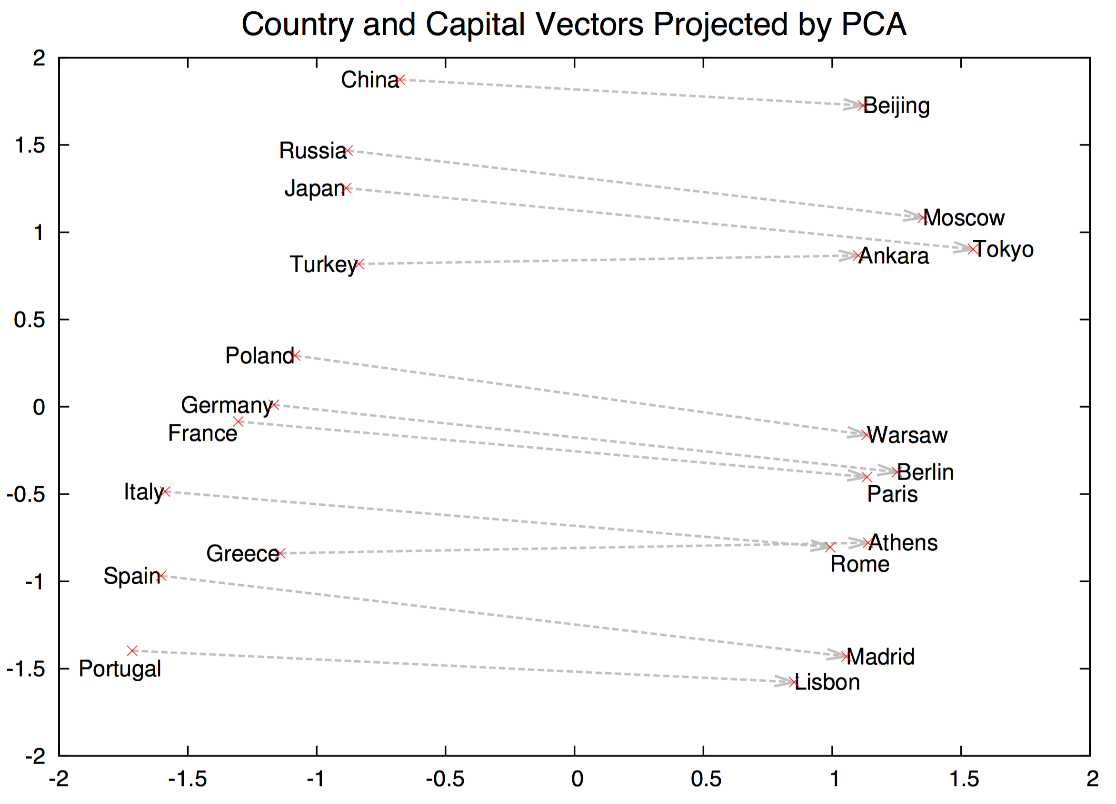
Observation in [Mikolov 2013a]
The difference between $\vec{v_{1}}$ and $\vec{v_{2}}$ captures the syntactic/semantic “relationship” between the two words!

Slide 20
Vector Difference Captures Relationship
$\vec{v}$(king) - $\vec{v}$(man) + $\vec{v}$(woman) = $\vec{v}$(queen)!!!
Experimental result
Trained RNN with m = 1600 on 320M words Broadcast News data
40% accuracy on syntactic relationship test (good:better – bad:worse)
First result showing that word vectors mean something much more than what had been expected
woman
queen
man
king

Slide 21
Many Questions…
Why does it work???? Why do these vectors capture semantics?
Is the result due to the particular choice of the neural network, RNN?
Shall we get better results if much larger dataset is used?

Slide 22
Follow Up: [Mikolov 2013b]
Questions
Is the result due to the particular choice of the neural network, RNN?
Shall we get better results if much larger dataset is used?
Q: How should we investigate these questions?
[Mikolov 2013b]
Trained word vectors using significantly simplified neural network models
Continuous Bag Of Words (CBOW) model
Continuous Skip-Gram model
Simpler models allowed significant reduction in training time.
Allows training on much larger dataset

Slide 23
CBOW Model: $P\left(w | w_{1},…, w_{n}\right)$
$$\vec{w_{1}}$$
$$\vec{v(t)}=W\vec{w(t)}$$
$$\vec{h}=(\vec{v\left(t\right)}+U\vec{s\left(t−1\right)})$$
$$\vec{y(t)}=V\vec{s(t)}$$
$$\vec{f(t)}=softmax(\vec{y(t)})$$
Much simpler model
Given $n$context words, predict the next word
…
W
$$\vec{v_{1}}$$
…
$$\vec{y}$$
…
$$\vec{h}$$
.
.
.
[m]
W’
…
[V]
+
softmax
…
$$\vec{w_{n}}$$
…
$$\vec{v_{n}}$$
[m]
[V]
…
…
…
[m]
[V]

Slide 24
Skip-Gram Model: $P\left(w_{k} | w\right)$
$$\vec{h}=W\vec{w}$$
$$\vec{y}=W′\vec{h}$$
$$\vec{f(t)}=softmax(\vec{y(t)})$$
Significantly simpler model
Not even addition of multiple context vectors
Given a word, predict $n$context words
“Inverse” prediction
For every word, $n$ training data instance is generated
$$\vec{w}$$
$$\vec{y}$$
$$\vec{h}$$
…
W
W’
…
softmax
…
…
…
[m]
[V]
[V]

Slide 25
Result of [Mikolov 2013b]
In general, Skip-Gram model performs best
Much better than his earlier model
Better than CBOW on average
The same “vector-difference relationship” holds
What does it mean?
The vector-difference result was not because of the particular choice of the neural network and/or loss function
Using more data makes things better
Probably the reason why Skip-Gram performs better than CBOW
But still, why does it work in the first place? What is the reason behind this magical result?

