Slide 1
CS249:
Word Embedding
Professor Junghoo “John” Cho

Slide 2
Today’s Topics
More on Word Embedding
  Tomas Mikolov, et al.: Efficient Estimation of Word Representations in Vector Space
  Tomas Mikolov, et al.: Distributed Representations of Words and Phrases and their Compositionality
  Jeffrey Pennington, et al.: GloVe: Global Vectors for Word Representation
  Quoc V. Le and Tomas Mikolov: Distributed Representations of Sentences and Documents

Slide 3
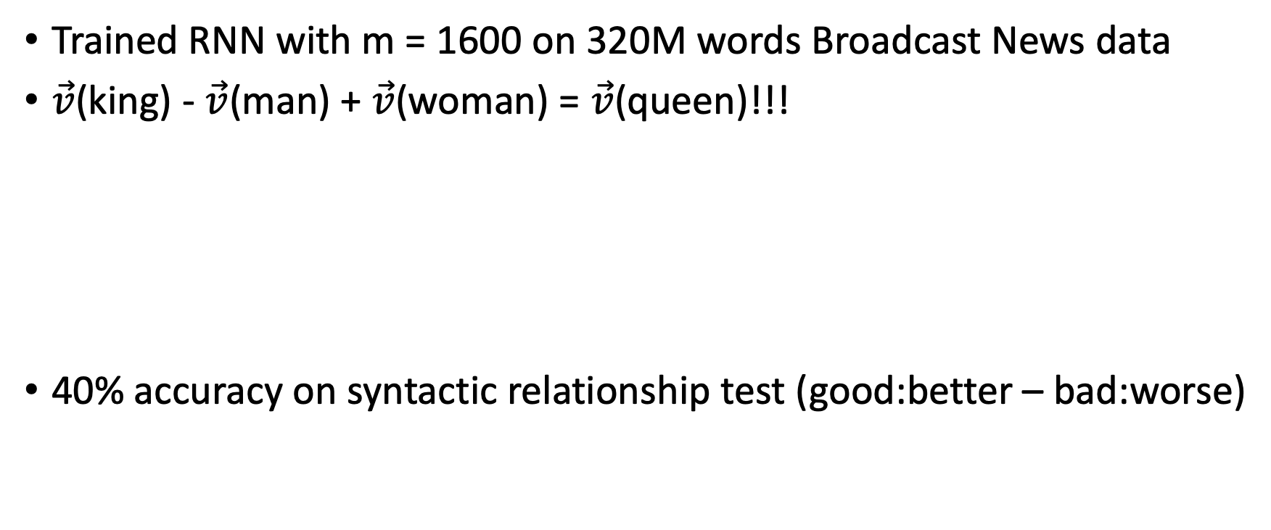
Vector Difference Captures Semantic Relationship! [Mikolov 2013a]
Trained RNN with m = 1600 on 320M words Broadcast News data
$\vec{v}$(king) - $\vec{v}$(man) + $\vec{v}$(woman) = $\vec{v}$(queen)!!!
40% accuracy on syntactic relationship test (good:better – bad:worse)
woman
queen
man
king

Slide 4
Question
Why does it work? Why do the vectors capture semantics?
  Not the result of a particular choice of the neural network
  There seems to be a fundamental reason behind this

Slide 5
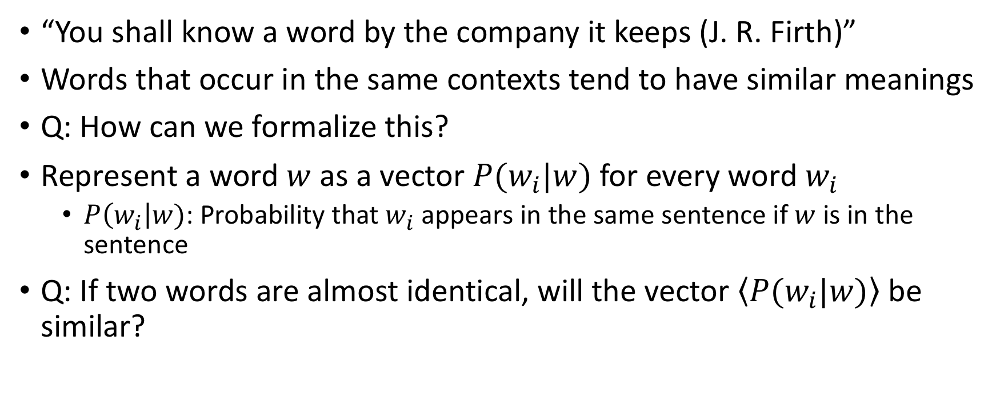
Distributional Hypothesis
“You shall know a word by the company it keeps (J. R. Firth)”
Words that occur in the same contexts tend to have similar meanings
Q: How can we formalize this?
Represent a word $w$ as a vector $P(w_{i}|w)$ for every word $w_{i}$
  $P\left(w_{i}\right|w)$: Probability that $w_{i}$ appears in the same sentence if $w$is in the sentence
Q: If two words are almost identical, will the vector $\left\langle P(w_{i}|w)\right\rangle$ be similar?

Slide 6
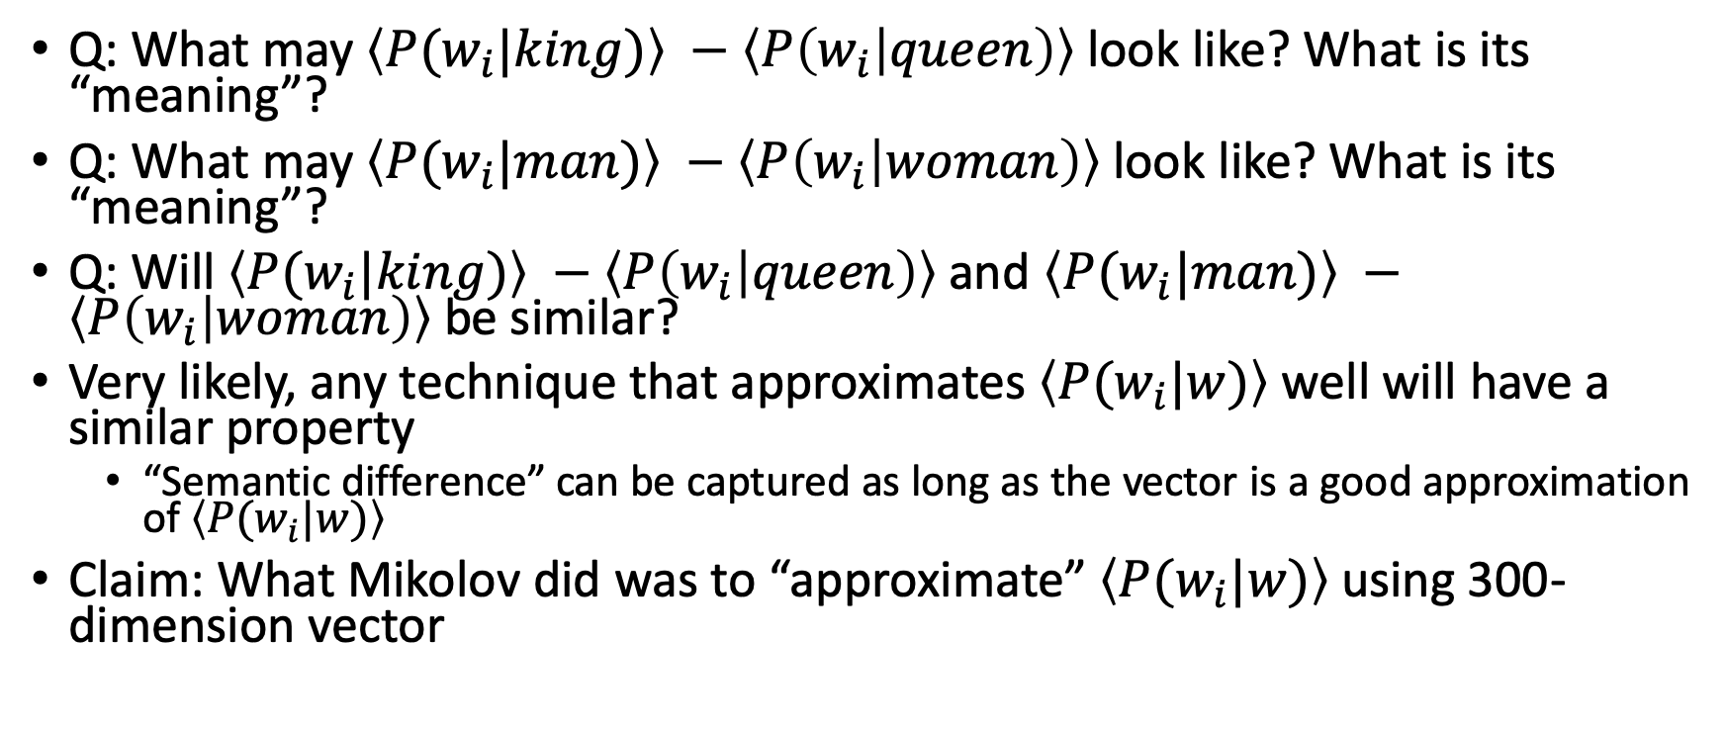
Distributional Hypothesis
Q: What may $\left\langle P(w_{i}|king)\right\rangle −\left\langle P\left(w_{i} | queen\right)\right\rangle$ look like? What is its “meaning”?
Q: What may $\left\langle P(w_{i}|man)\right\rangle −\left\langle P\left(w_{i} | woman\right)\right\rangle$ look like? What is its “meaning”?
Q: Will $\left\langle P(w_{i}|king)\right\rangle −\left\langle P\left(w_{i} | queen\right)\right\rangle$and $\left\langle P(w_{i}|man)\right\rangle −\left\langle P\left(w_{i} | woman\right)\right\rangle$ be similar?
Very likely, any technique that approximates $\left\langle P(w_{i}|w)\right\rangle$ well will have a similar property
  “Semantic difference” can be captured as long as the vector is a good approximation of $\left\langle P(w_{i}|w)\right\rangle$
Claim: What Mikolov did was to “approximate” $\left\langle P(w_{i}|w)\right\rangle$ using 300-dimension vector

Slide 7
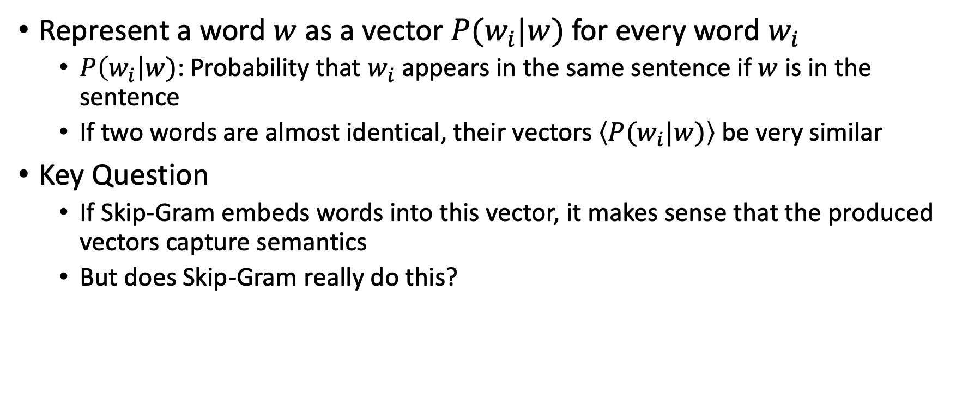
Summary: Distributional Hypothesis
Represent a word $w$ as a vector $P(w_{i}|w)$ for every word $w_{i}$
  $P\left(w_{i}\right|w)$: Probability that $w_{i}$ appears in the same sentence if $w$is in the sentence
  If two words are almost identical, their vectors $\left\langle P(w_{i}|w)\right\rangle$ be very similar
Key Question
  If Skip-Gram embeds words into this vector, it makes sense that the produced vectors capture semantics
  But does Skip-Gram really do this?

Slide 8
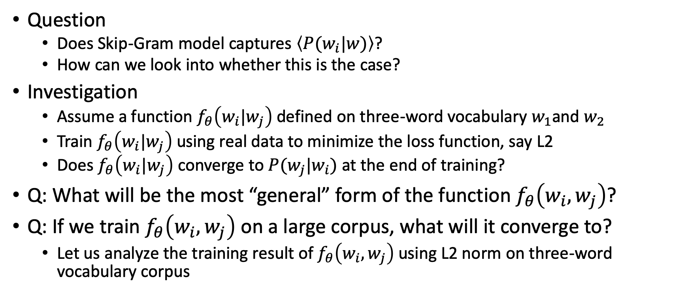

Skip-Gram and $\left\langle P(w_{i}|w)\right\rangle$
Question
  Does Skip-Gram model captures $\left\langle P(w_{i}|w)\right\rangle$?
  How can we look into whether this is the case?
Investigation
  Assume a function $f_{θ}\left(w_{i}|w_{j}\right)$ defined on three-word vocabulary $w_{1}$and $w_{2}$
  Train $f_{θ}\left(w_{i}|w_{j}\right)$ using real data to minimize the loss function, say L2
  Does $f_{θ}\left(w_{i}|w_{j}\right)$ converge to $P(w_{j}|w_{i})$ at the end of training?
Q: What will be the most “general” form of the function $f_{θ}\left(w_{i},w_{j}\right)$?
Q: If we train $f_{θ}\left(w_{i},w_{j}\right)$ on a large corpus, what will it converge to?
  Let us analyze the training result of $f_{θ}\left(w_{i},w_{j}\right)$ using L2 norm on three-word vocabulary corpus

Slide 9
Follow-up: [Mikolov 2013c]
Problem: For a large corpus, even CBOW/skip-gram models are too slow to train
  For 320M word corpus, training CBOW/skip-gram models took days.
Q: Can we make CBOW/Skip-Gram model more efficient, so that we can run it on a larger corpus?
  Larger data will likely lead to even better embedding

Slide 10



Question of [Mikolov 2013c]
Q: Why does it take so long to train them?
A: Two main reasons
  Large training data
  Computational complexity of the model, particularly the softmax layer
Q: How can we reduce the bottlenecks?
$$\vec{w}$$
$$\vec{y}$$
$$\vec{h}$$
…
W
W’
…
softmax
…
…
…
[m]
[V]
[V]

Slide 11
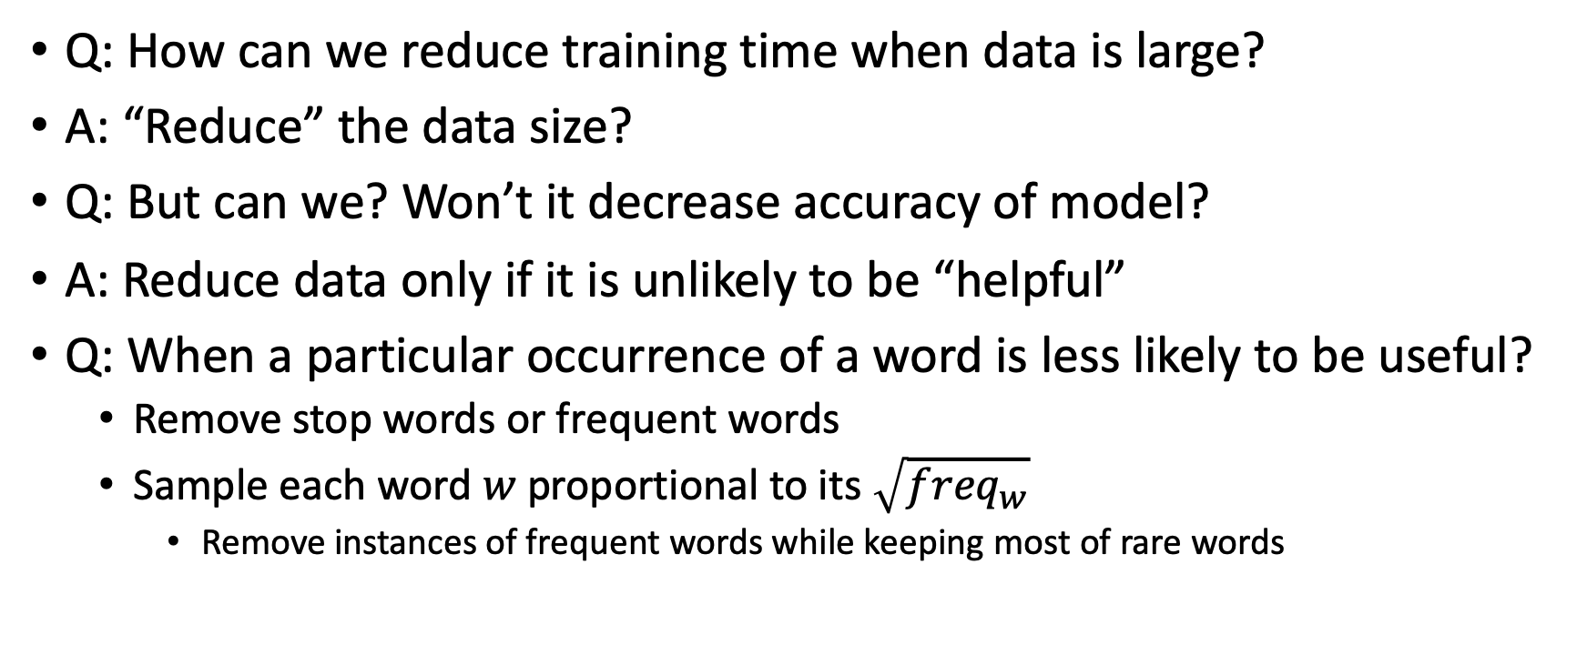
Overhead from Large Training Data
Q: How can we reduce training time when data is large?
A: “Reduce” the data size?
Q: But can we? Won’t it decrease accuracy of model?
A: Reduce data only if it is unlikely to be “helpful”
Q: When a particular occurrence of a word is less likely to be useful?
  Remove stop words or frequent words
  Sample each word $w$proportional to its $\sqrt{{freq}_{w}}$
    Remove instances of frequent words while keeping most of rare words

Slide 12


Overhead from Softmax Layer
At softmax layer, every training instance incurs backpropagation of errors for every word in the vocabulary!
Q: How can we minimize this overhead?
Q: Do we really have to backpropagate errors for every word?
A: For “negative” words, sample only a few, not all, and back propagate errors only for them
$$\vec{w}$$
$$\vec{y}$$
$$\vec{h}$$
…
W
W’
…
softmax
…
…
…
[m]
[V]
[V]

Slide 13
Result of [Mikolov 2013c]
Both techniques, frequent-word subsampling and negative sampling, significantly reduce training time
Both techniques have negligible impact on the quality of trained word vectors
Training on a larger corpus improves the quality of trained word vectors

Slide 14
Questions?
Next Topic: GloVe [Pennington et al. 2014]

Slide 15
GloVe [Pennington et al. 2014]
Key observation?
Distributional hypothesis: the ratio of conditional probabilities captures the key difference of two words well
  Ice vs steam
    Large difference in the ratio of conditional probabilities for solid and gas

Slide 16
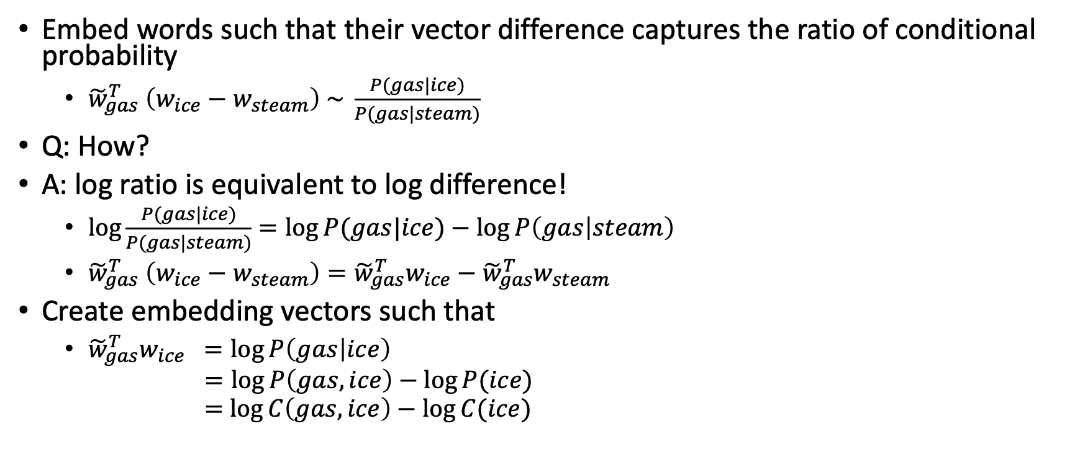
GloVe [Pennington et al. 2014]
Embed words such that their vector difference captures the ratio of conditional probability
  ${\tilde{w}}_{gas}^{T} \left(w_{ice}−w_{steam}\right) \sim \frac{P(gas|ice)}{P(gas|steam)}$
Q: How?
A: log ratio is equivalent to log difference!
  $\log{\frac{P(gas|ice)}{P(gas|steam)}}=\log{P(gas|ice)}−\log{P\left(gas | steam\right)}$
  ${\tilde{w}}_{gas}^{T} \left(w_{ice}−w_{steam}\right)={\tilde{w}}_{gas}^{T}w_{ice}−{\tilde{w}}_{gas}^{T}w_{steam}$
Create embedding vectors such that
  ${\tilde{w}}_{gas}^{T}w_{ice} =\log{P\left(gas | ice\right)}$
  $=\log{P\left(gas,ice\right)−\log{P(ice)}}$
  $=$ $\log{C\left(gas,ice\right)−\log{C(ice)}}$

Slide 17
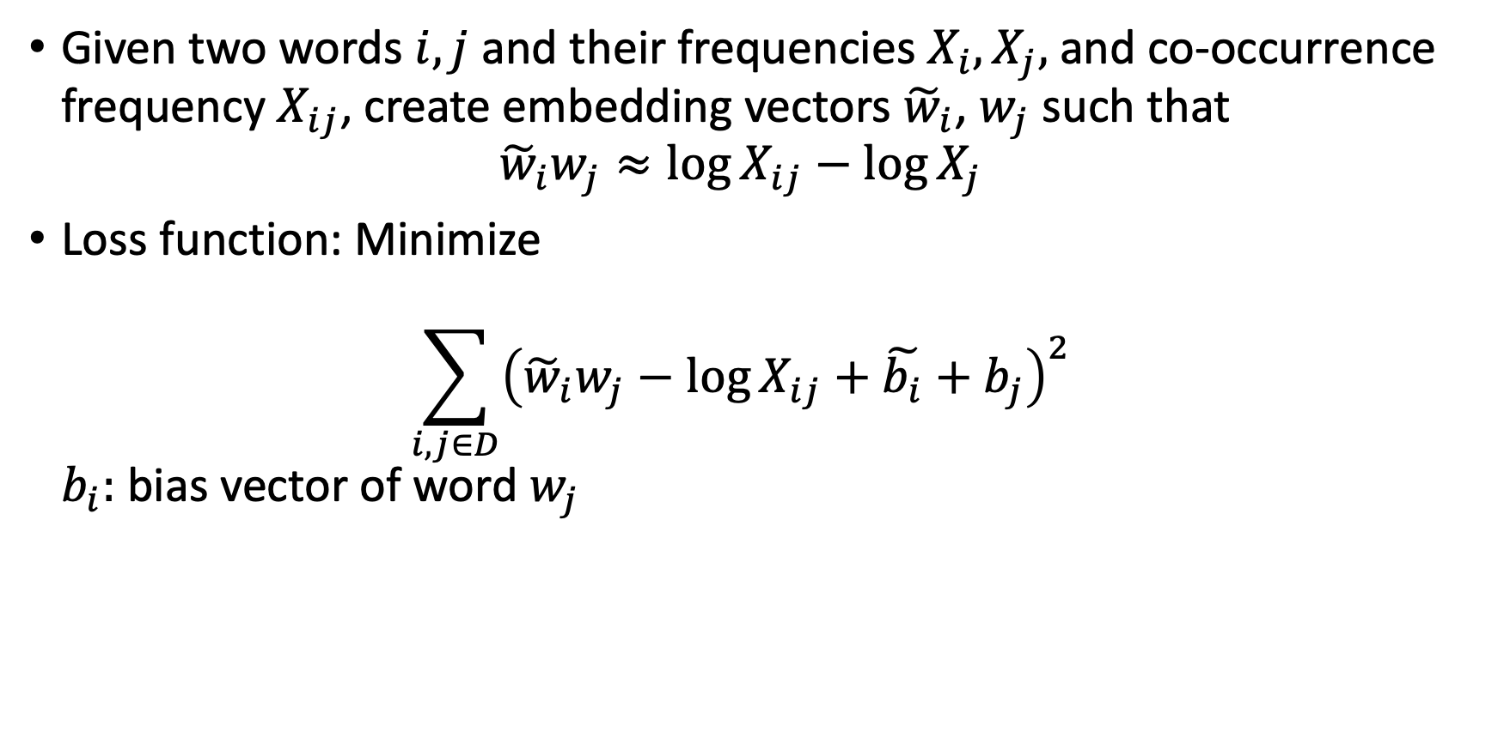
GloVe [Pennington et al. 2014]
Given two words $i, j$ and their frequencies $X_{i},X_{j},$and co-occurrence frequency $X_{ij}$, create embedding vectors ${\tilde{w}}_{i}$, $w_{j}$ such that
${\tilde{w}}_{i}w_{j}≈\log{X_{ij}−\log{X_{j}}}$
Loss function: Minimize
$\sum_{i,j∈D}{{\left({\tilde{w}}_{i}w_{j}−\log{X_{ij}+\tilde{b_{i}}+b_{j}}\right)}^{2}}$
$b_{i}:$ bias vector of word $w_{j}$

Slide 18
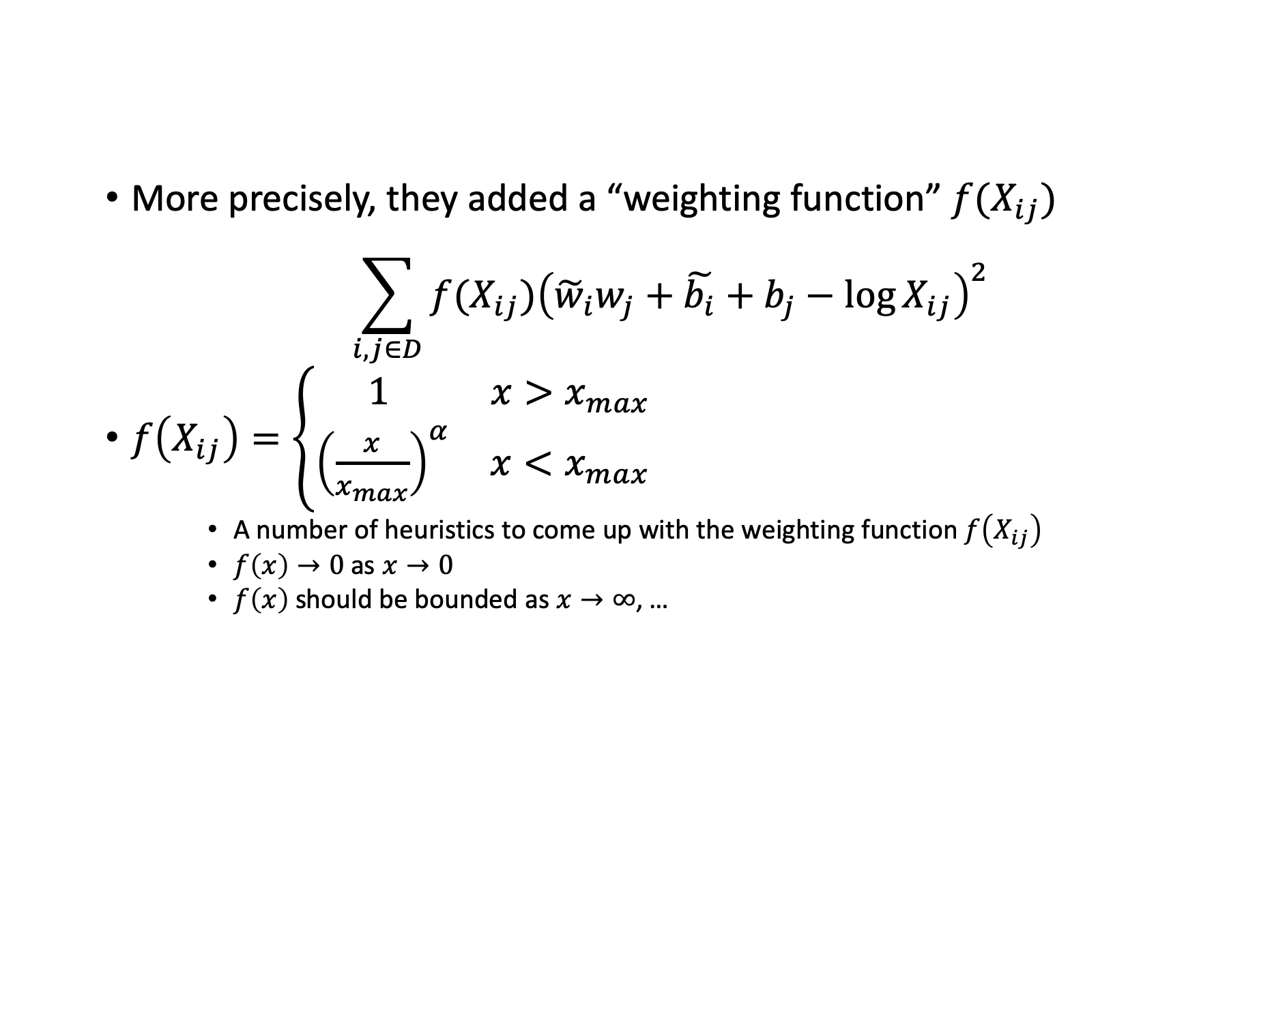
GloVe [Pennington et al. 2014]
More precisely, they added a “weighting function” $f(X_{ij})$
$\sum_{i,j∈D}{f(X_{ij}){\left({\tilde{w}}_{i}w_{j}+\tilde{b_{i}}+b_{j}−\log{X_{ij}}\right)}^{2}}$
$f\left(X_{ij}\right)=\left\{\begin{aligned}\begin{matrix} 1 & x>x_{max}\end{matrix} \\ \begin{matrix}{\left(\frac{x}{x_{max}}\right)}^{α} & x<x_{max}\end{matrix}\end{aligned}\right.$
    A number of heuristics to come up with the weighting function $f\left(X_{ij}\right)$
    $f\left(x\right)→0$ as $x→0$
    $f\left(x\right)$ should be bounded as $x→∞$, …

Slide 19
Result of GloVe
Accuracy: 80% on semantic task, 70% on syntactic task
Context size: Larger context window size improves semantic tasks but not syntactic tasks

Slide 20
Result of GloVe
L2 distance between words captures their semantic distance well
In practice, the effectiveness of word2vec and GloVe seem comparable for most downstream NLP tasks

Slide 21
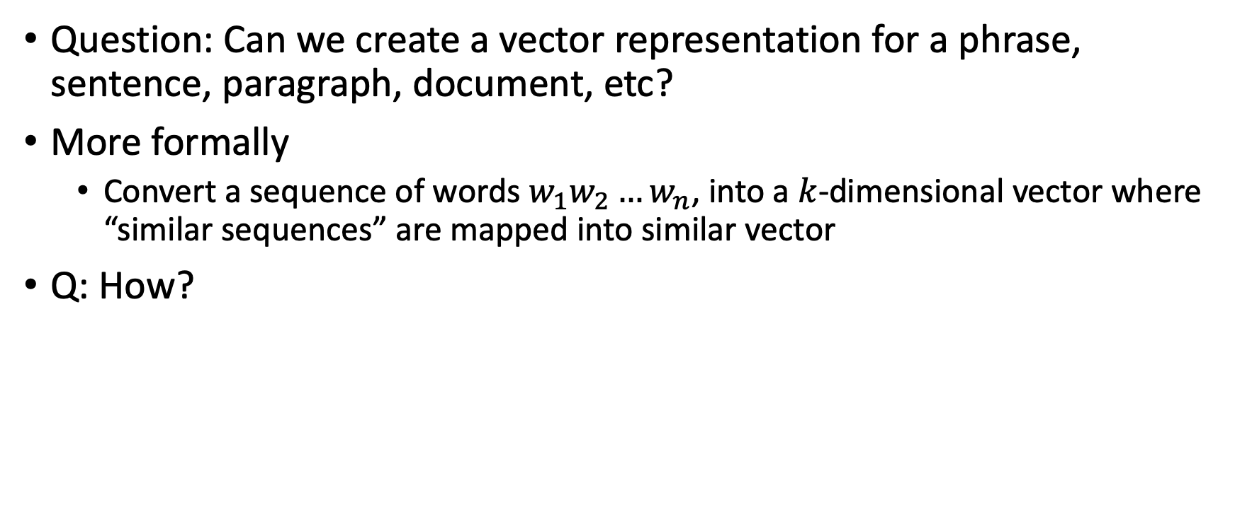
Paragraph Embedding [Le & Mikolov 2014]
Question: Can we create a vector representation for a phrase, sentence, paragraph, document, etc?
More formally
  Convert a sequence of words $w_{1}w_{2}…w_{n}$, into a $k$-dimensional vector where “similar sequences” are mapped into similar vector
Q: How?

Slide 22
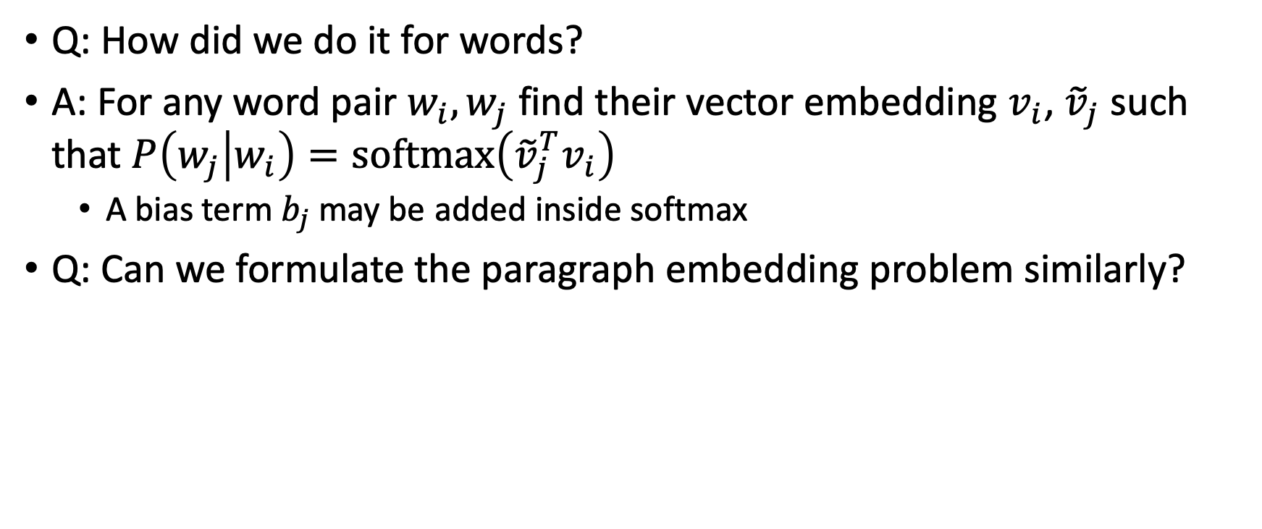
Paragraph Embedding [Le & Mikolov 2014]
Q: How did we do it for words?
A: For any word pair $w_{i}, w_{j}$ find their vector embedding $v_{i}$, ${\tilde{v}}_{j}$ such that $P\left(w_{j} | w_{i}\right)=softmax\left({\tilde{v}}_{j}^{T}v_{i}\right)$
  A bias term $b_{j}$may be added inside softmax
Q: Can we formulate the paragraph embedding problem similarly?

Slide 23



PV-DBOW (Bag of Words of Paragraph Vector)
Given $p_{i}=w_{1}w_{2}…w_{n}$, find their vector embedding $q_{i}, {\tilde{v}}_{1},{\tilde{v}}_{2},…,{\tilde{v}}_{n}$ such that
$P\left(w_{j} | p_{i}\right)=softmax\left({\tilde{v}}_{j}^{T}q_{i}\right)$
  Again, a bias term $b_{j}$ maybe added
Train $q_{i}, {\tilde{v}}_{j}$ vectors on large text corpus to
maximize the log likelihood $\sum_{\left(i,j\right)∈D}{\log{P(w_{i}}|p_{j})}$
$${(\tilde{v}}_{j}, b_{j})$$
$$q_{i}$$

Slide 24






PV-DM
(Distributed Memory for Paragraph Vector)
Given $p_{i}=w_{1}w_{2}…w_{n}$, find their vector embedding $q_{i}, v_{1},…, v_{n}, {\tilde{v}}_{1}, …,{\tilde{v}}_{n}$ such that
$P\left(w_{4} | p_{i}w_{1}w_{2}w_{3}\right)=softmax\left({\tilde{v}}_{4}^{T}\left[q_{i}v_{1}v_{2}v_{3}\right]\right)$
  A bias term $b_{4}$ may be added
Train $q_{i}, {v_{j}, \tilde{v}}_{j}$ vectors on large text corpus
to maximize the log likelihood
$\sum_{\left(i,j\right)∈D}{\log{P(w_{i}}|p_{j})}$
${(\tilde{v}}_{4}, b_{4})$
Concatenate/average
$$q_{i}$$
$$v_{1}$$
$$v_{2}$$
$$v_{3}$$

Slide 25
Results of [Le & Mikolov 2014]
PV-DM works better than PV-DBOW
  Slight improvement when used together
12.2% error rate for Stanford sentiment analysis task using PV
  20% improvement from state-of-the-art
7.42% error rate for IMDB review sentiment analysis task
  15% improvement from state-of-the-art
3.82% error rate for paragraph similarity task
  32% improvement from state-of-the-art
Vector embedding works well at the sentence/paragraph level!

Slide 26
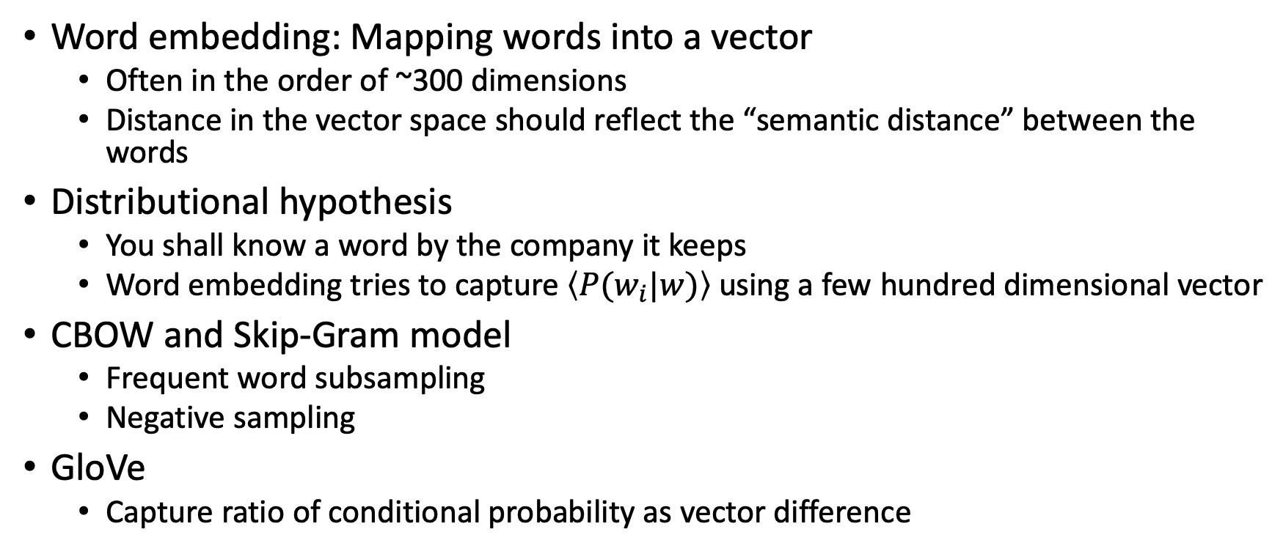
Summary
Word embedding: Mapping words into a vector
  Often in the order of ~300 dimensions
  Distance in the vector space should reflect the “semantic distance” between the words
Distributional hypothesis
  You shall know a word by the company it keeps
  Word embedding tries to capture $\left\langle P(w_{i}|w)\right\rangle$ using a few hundred dimensional vector
CBOW and Skip-Gram model
  Frequent word subsampling
  Negative sampling
GloVe
  Capture ratio of conditional probability as vector difference

Slide 27
Vector Embedding
Today, word embedding is used as the first step in almost all NLP tasks
  Word2Vec, GloVe, ELMO, BERT, …
In general, “vector embedding” is an extremely hot research topic for many different types of datasets
  Graph embedding
  User embedding
  Time-series data embedding
  …
Any questions?

Slide 28
Announcement
Start preparing your presentation
  Your presentations will start week 4!
Decide project ideas for your group
  Project proposal is due by 5th week
  Project idea presentation during the 5th week
  Working on a Kaggle competition can be an option
If you get stuck,
  I am available to help
  Leverage my office hour to your advantage

