Slide 1
CS249: Text Classification and Expectation Maximization
Junghoo “John” Cho
UCLA

Slide 2
Today’s Topic
[Nigam 99] Text Classification from Labeled and Unlabeled Documents using EM
Text classification problem
Naïve Bayes classifier
Expectation-Maximization (EM) algorithm

Slide 3
Text Classification
Given a document $d$, classify $d$ as one of $k$ classes
Many applications
Is an email a spam or not?
Is this paper about CS/biology/history/…?
Will the user likely to read this news or not?
Will the customer likely to buy this book or not?
Q: How can a computer classify text?
Q: How can we formalize this problem?

Slide 4
Problem Setup
“Find” the classification function $f(d)$ that returns $1, …, k$ given a document $d$
$f:d →\{1, …, k\}$
Q: How?
A: Two approaches
Let the computer “learn” $f\left(d\right)$ from examples: $\{\left(d_{1}, 3\right), \left(d_{2}, 1\right), …, \left(d_{n}, 2\right)\}$
“Supervised learning” from training data
Let the computer figure out inherent document classes from a set of documents $D=\{d_{1}, d_{2}, …, d_{n}\}$
“Unsupervised learning”

Slide 5
Document Classification: Supervised Learning
Q: How can a machine learn $f(d)$ from $\{\left(d_{1}, 3\right), \left(d_{2}, 1\right), …, \left(d_{n}, 2\right)\}$?
Q: What information in $d_{i}$ can be useful to identify its class?
Key idea of text classification
Each class $c_{i}$ has a few “key” words that strongly indicate the class
Examples
Politics: election, senate, president, district, …
Spam: win, prize, sale, flash, …
Classify a document $d$ as $c_{i}$ if $d$ contains keywords of $c_{i}$
Q: How can we formalize this?
Q: Can we build a formal model that captures the relationship between a document class $c_{i}$ and its keywords?

Slide 6
Simple Document Generative Model
Word probability vector $\left(P\left(w_{1} | c_{i}\right), P\left(w_{2} | c_{i}\right), …, P\left(w_{V} | c_{i}\right)\right)$
The probability that the word $w_{j}$ is chosen when a document of class $c_{i}$ is written
$\sum_{j=1}^{V}{P\left(w_{j} | c_{i}\right)}=1$
Q: What is the dimension of the vector?
Q: How many such vectors exist?

Slide 7
Simple Document Generative Model
The author picks the document class $c_{i}$ before writing a document $d$
At $j$th word position of $d,$a word $w_{k}$ chosen randomly with probability $P(w_{k}|c_{i})$
Q: Does this generative model capture the relationship between a document class and its keywords? How?
Q: Why does it assume words are chosen independently at random given $c_{i}$ at each word position? Is it realistic?

Slide 8
Computing Probability from Model
$c_{1}=\left\{w_{1}:0.7, w_{2}:0.2, { w}_{3}:0.1\right\}$ $c_{2}=\left\{w_{1}:0.2, { w}_{2}:0.1, { w}_{3}:0.7\right\}$ $d$ has three words $d=\{w_{1}w_{2}w_{1}\}$
Q: If $d$’s class is $c1$, what is its generation probability?
Q: If $d$’s class is $c2$, what is its generation probability?
Q: Between $c1$ and $c2$, what is a better guess?
Q: How can we formalize this?

Slide 9
Naïve Bayes Classifier
$$=P\left(c_{i} | w_{1}w_{2}…w_{n}\right)$$
$P\left(c_{i} | d\right)$
Q: How can we calculate posterior distribution given $d$?
Q: Where do we get likelihood and prior?
$$=\frac{P(w_{1}w_{2}…w_{n}|c_{i})P(c_{i})}{P(w_{1}w_{2}…w_{n})}$$
$$∝P\left(w_{1}w_{2}…w_{n} | c_{i}\right)P\left(c_{i}\right)$$
$$=P\left(w_{1} | c_{i}\right)⋯P\left(w_{n} | c_{i}\right)P\left(c_{i}\right)$$
$$P\left(c_{i} | d\right)∝P\left(w_{1} | c_{i}\right)⋯P\left(w_{n} | c_{i}\right) P\left(c_{i}\right)$$
“Posterior distribution”
“Likelihood”
“Prior distribution”

Slide 10
Naïve Bayes Classifier: Learning Parameters
Q: Given training data $\{\left(d_{1}, 3\right), \left(d_{2}, 1\right), …, \left(d_{n}, 2\right)\}$, what will be a good guess for likelihood $P(w_{j}|c_{i})$ and prior $P\left(c_{i}\right)$?
$P\left(c_{i}\right)= \frac{\#c_{i}}{n}$
$P\left(w_{j} | c_{i}\right)= \frac{\#w_{j} in documents of c_{i}}{total word counts in documents of c_{i}}$
Laplace smoothing: $+1$

Slide 11
Algorithm: Naïve Bayes Classifier
From $\{\left(d_{1}, 3\right), \left(d_{2}, 1\right), …, \left(d_{n}, 2\right)\}$:
Estimate $P\left(c_{i}\right)= \frac{\#c_{i}}{n}$, $P\left(w_{j} | c_{i}\right)= \frac{\#w_{j} in c_{i}}{total word counts in c_{i}}$
Given a new document $d=w_{1}…w_{n}$:
$$P\left(c_{i} | d\right)=P\left(w_{1} | c_{i}\right)⋯P\left(w_{n} | c_{i}\right) P\left(c_{i}\right)$$
“Naïve Bayes classifier”
Bayesian inference + naïve (independence) assumption
In short, “multiply word frequency counts of each class”!

Slide 12
Questions?

Slide 13
Text Classification: Unsupervised
Q: How can a machine learn $f:d→\{1, …, k\}$ from a set of unlabeled documents $D=\{d_{1}, d_{2}, …, d_{n}\}$?
Key idea
Documents form natural “clusters” around topics
Example
Politics: election, vote, district, senate, president, …
CS: computer, algorithm, software, database, …

Slide 14
Clustering Property
Algorithm
Election

Slide 15
Identifying Clusters
Q: How can a machine automatically assign data points into clusters?
A: Key idea
Given $k$clusters, assign each data point to the “nearest” cluster
Q: How to choose the initial $k$ clusters?
A: Start with random clusters and refine iteratively!

Slide 16
K-Means Clustering: Algorithm
Start with $k$ random points $\left\{c_{1},…, c_{k}\right\}$ as the “cluster center”
Repeat until no change
Assignment Step:
Assign each data point $x∈X$ to the cluster $C_{i}$if its center $c_{i}$is closest
Update Step:
Adjust “center center” based on the current assignments:
$$c_{i}= \frac{1}{|C_{i}|}\sum_{x∈C_{i}}{x}$$

Slide 17
K-Means Clustering: 4-Cluster Example
Image credit: http://shabal.in/

Slide 18
Formalizing Clustering
K-means clustering is reasonable, but it is still an ad hoc heuristics
No formal “guarantee”
Q: Can we make the idea of K-means clustering more formal?
Q: Can we come up with a probabilistic generative model for clusters?
Q: How can we capture the relationship between “clusters” and each data point in a model?

Slide 19
Mixture Model
Probabilistic generative model for clustering
Data is generated from one of $k$ “hidden clusters” (= latent models)
Each of the $k$ latent models has its own data distribution

Slide 20
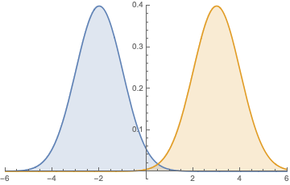
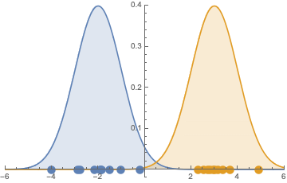
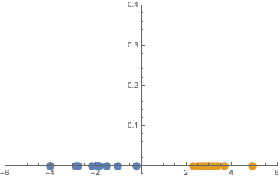
Gaussian Mixture Model (GMM): Example
Each data is generated from one of two Gaussian distributions
The location and shape of the Gaussian distribution is unknown

Slide 21
Gaussian Mixture Model (GMM)
Q: Does the model capture the clustering property of the data?
Q: If so, how is it captured?
Q: Given the model, how can we learn the “hidden clusters” from data only? How to formalize this?

Slide 22
Learning the Mixture Model
Given dataset $X$ and a $k$-mixture model, we need to learn
For each $x∈X$, the model from which $x$ was generated
The parameters of each model (e.g., mean $μ$ and variance $σ^{2}$of Gaussian distribution)
The chosen model becomes the class that $x$ belongs to
Q: How can we do this?
A: Start with random guess and refine iteratively!
Expectation-Maximization (EM) algorithm
Very similar to $k$-means clustering

Slide 23
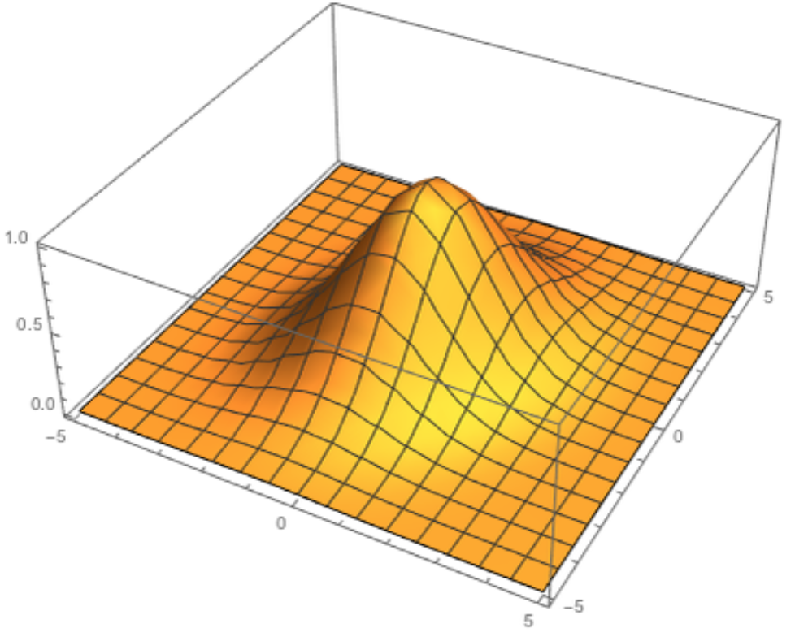
Example: Bivariate Gaussian Distribution
Image credit: Wikipedia
Image credit: Robert L. Brown from MathWorld

Slide 24
EM for GMM: Example
Image credit: Eric Xing @ CMU

Slide 25
Expectation-Maximization (EM) Algorithm
Start with a “random guess” on model parameters $(μ$ and $σ)$
Repeat until no change
Expectation step:
For $x∈X,$ compute $P(c_{k}|x)$: probability that $x$ is generated from $k$th model
Maximization step:
From current estimation of $P(c_{k}|x)$, compute the model parameters $(μ$ and $σ$ of each model)
Q: How do we compute $P\left(c_{k} | x\right)$ during expectation step? How do we compute $μ$ and $σ$ during maximization step?

Slide 26
Expectation Step
Compute expected cluster membership $P\left(c_{k}\right|x)$
$P\left(c_{k}\right|x)=\frac{P(x|c_{k})P(c_{k})}{P(x)}∝P\left(x | c_{k}\right)P(c_{k})$
$P\left(x | c_{k}\right)=P\left(x | μ_{k}, σ_{k}\right)= \frac{1}{σ\sqrt{2π}}e^{−{\left(x−μ_{k}\right)}^{2}/2σ_{k}^{2}}$

Slide 27
Maximization Step
Compute cluster parameter $μ_{k}$ and $σ_{k}$
$μ_{k}=\frac{1}{|X|}\sum_{x∈X}{P\left(c_{k} | x\right) x}$ : average $x$ value in $c_{k}$
$σ_{k}^{2}=\frac{1}{|X|}\sum_{x∈X}{P\left(c_{k} | x\right) {\left(x−μ_{k}\right)}^{2}}$ : average ${\left(x−μ_{k}\right)}^{2}$ value in $c_{k}$

Slide 28
Mixture Model for Text Classification
Q: How should we change the model for text classification?
Instead of $μ$ and $σ$, each of the $k$models is associated with word probability vector $\left(P\left(w_{1} | c_{i}\right), P\left(w_{2} | c_{i}\right), …, P\left(w_{V} | c_{i}\right)\right)$
The probability that word $w_{j}$ is used in a document of class $c_{i}$
The same EM algorithm is used to identify $k$document clusters
Q: How do expectation and maximization steps change?

Slide 29
EM Algorithm for Text Classification
Start with a “random guess” on model parameters
Repeat until no change
Expectation step:
For $d∈D,$ compute $P(c_{k}|d)$: probability that $x$ is generated from $k$th model
$P\left(c_{i} | d\right)∝P\left(w_{1} | c_{i}\right)⋯P\left(w_{n} | c_{i}\right)P\left(c_{i}\right)$
Maximization step:
From current estimation of $P(c_{k}|d)$, compute the model parameters
$P\left(w_{j} | c_{i}\right)= \frac{\#w_{j} in c_{i}}{total word counts in c_{i}}$ (counts should be weighted by $P\left(c_{i} | d\right)$ for each $d$)

Slide 30
[Nigam 99] Key idea
Q: Can we use both labeled and unlabeled documents for text classification?
Improve results from labeled data $D_{L}$by using unlabeled data $D_{U}$!
Combination of supervised and unsupervised algorithm
Q: How?

Slide 31
EM Algorithm for Unlabeled Data
Start with a “random guess” on model parameters
Repeat until no change
Expectation step:
For $d∈D,$ compute $P(c_{k}|d)$: probability that $d$ is generated from $k$th model
$P\left(c_{i} | d\right)∝P\left(w_{1} | c_{i}\right)⋯P\left(w_{n} | c_{i}\right)P\left(c_{i}\right)$
Maximization step:
From current estimation of $P(c_{k}|d)$, compute the model parameters
$P\left(w_{j} | c_{i}\right)= \frac{\#w_{j} in c_{i}}{total word counts in c_{i}}$
Q: How should we change the algorithm if labeled data is available?

Slide 32
EM Algorithm for both $D_{L}$ and $D_{U}$
Initialize $P\left(w_{j} | c_{i}\right)$ from labeled documents $D_{L}$
Repeat until no change
Expectation step:
For $d∈D,$ compute $P(c_{k}|d)$: probability that $d$ is generated from $k$th model
$P\left(c_{i} | d\right)∝P\left(w_{1} | c_{i}\right)⋯P\left(w_{n} | c_{i}\right)P\left(c_{i}\right)$
Maximization step:
From current estimation of $P(c_{k}|d)$, compute the model parameters
$P\left(w_{j} | c_{i}\right)= \frac{\#w_{j} in c_{i}}{total word counts in c_{i}}$

Slide 33
EM Algorithm for both $D_{L}$ and $D_{U}$
Initialize $P\left(w_{j} | c_{i}\right)$ from labeled documents $D_{L}$
Repeat until no change
Expectation step:
For $d∈D_{U},$ compute $P(c_{k}|d)$: probability that $d$ is generated from $k$th model
$P\left(c_{i} | d\right)∝P\left(w_{1} | c_{i}\right)⋯P\left(w_{n} | c_{i}\right)P\left(c_{i}\right)$
Maximization step:
From current estimation of $P(c_{k}|d)$, compute the model parameters
$P\left(w_{j} | c_{i}\right)= \frac{\#w_{j} in c_{i}}{total word counts in c_{i}}$

Slide 34
EM Algorithm for both $D_{L}$ and $D_{U}$
Initialize $P\left(w_{j} | c_{i}\right)$ from labeled documents $D_{L}$
Repeat until no change
Expectation step:
For $d∈D_{U},$ compute $P(c_{k}|d)$: probability that $d$ is generated from $k$th model
$P\left(c_{i} | d\right)∝P\left(w_{1} | c_{i}\right)⋯P\left(w_{n} | c_{i}\right)P\left(c_{i}\right)$
Maximization step:
From current estimation of $P(c_{k}|d)$, compute the model parameters
$P\left(w_{j} | c_{i}\right)=\frac{\#w_{j} in{ c}_{i} of D_{L}}{total word counts in c_{i} of D_{L}}+λ\frac{\#w_{j} in{ c}_{i} of D_{U}}{total word counts in c_{i} of D_{U}}$

Slide 35
Summary
Text Classification
Supervised vs unsupervised
Naïve Bayes classifier
K-means clustering
Assignment and update steps
Mixture model and Expectation-Maximization algorithm
Unknown model membership (discrete latent variable) and model parameters
Expectation and maximization steps
Questions?

Slide 36
Reminder
Project presentation in 5th week
Proposal is due at the end of 5th week
Discuss project ideas with your partners now!

